Slide 1
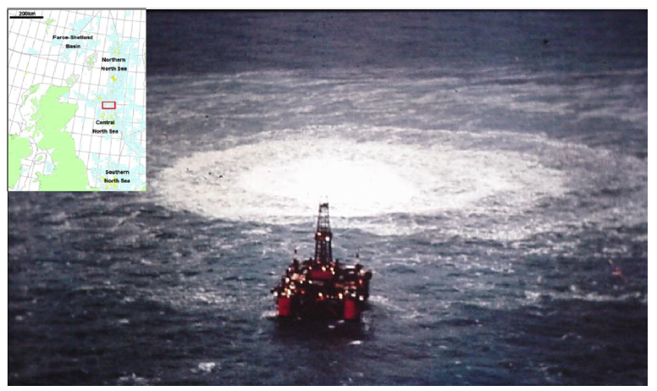
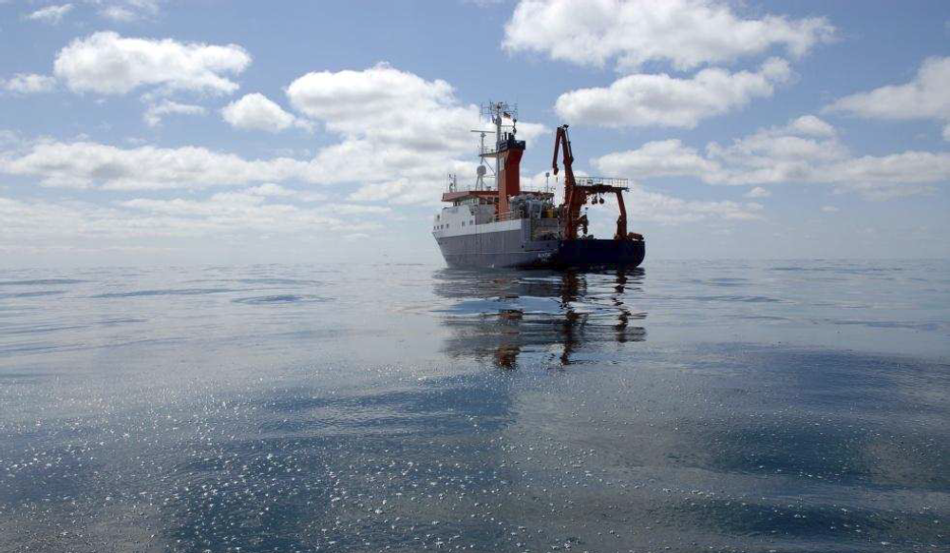
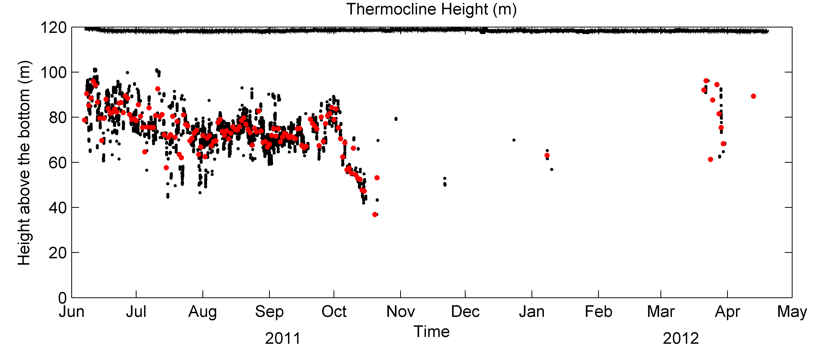
Bubble momentum plume & an early breakdown of the seasonal stratification published in: Journal of Marine and Petroleum Geology, special issue on site 22/4b (2015)
Janine Nauw (jnauw@nioz.nl, NIOZ), Peter Linke (HZG-GEOMAR) and Ira Leifer (UCSB, USA)
NIOZ is an institute of the Netherlands Organisation for Scientific Research (NWO)
Introduction: The presence of a seasonal thermocline may play a role in retaining methane released from a seabed source in the lower layer, inhibiting exchange to the atmosphere (Fig. 2). Hypothesis: A bubble plume generates upwelling and may cause an early breakdown of the seasonal thermocline. Measurements at site 22/4b (57º55’N, 1º38’E) in the UK Central North Sea (Fig. 1), where gas is being released since a blowout in 1990, have been used to identify the generation of the seasonal thermocline and the timing of its breakdown in autumn (Nauw et al., 2015a).
PROVESS
Fig 3:Time-series of:
― Near Bottom Temperature (black line)
• Sea Surface Temperture MODIS (black dots)
•- SST climatology (Berx, 2009)
•- NBT climatology (Berx, 2009)
•- SST CTD-profiles
•- NBT CTD-profiles
22/4b
Fig. 1: Topography and currents in the northern North Sea under stratified summer conditions
Summer
Winter
Blowout 1990
• location of the thermocline & ―linear regression
Limited exchange
Strong exchange
Methane trapped
below thermocline
No thermocline!
mixing
Microbial degradation
+ dissolution
Lateral
Transport?
Microbial degradation
+ dissolution
Fig 6: Vertical shear: |S|=|$\sqrt{{\left(\frac{∂u}{∂z}\right)}^{2}{+\left(\frac{∂v}{∂z}\right)}^{2}}$|
Fig. 2: Schematic of exchange of methane to the atmosphere during summer and winter conditions, see review on North Sea hydrodynamics: Nauw et al. (2015b).
Results: Acoustic Doppler Current Profiler (ADCP) and temperature data on a lander in the crater show an early breakdown of the thermocline most likely on 9 November 2011, when the SST drops below NBT and large temperature variations cease to exist (Fig. 3). In that period, also the local maximum backscatter intensity reaches the bottom (Fig. 5), the high shear layer |S| becomes disconnected from the bottom (Fig. 6) and a frontal jet passes site 22/4b (Fig. 7).
• Depth thermocline - local max I
• Top/Base thermocline CTD-profiles
Survey 2011
Fig. 4: Log(Backscater Intensity) & Abs (vertical shear, |S|)
Fig 7: Residual northward current (m/s) from a 1-day running harmonic analysis & the M2 tidal constituent.
Conclusions:
1) Thermocline breaks down anomalously early at site 22/4b as compared to PROVESS (Fig. 1 & Howarth, 2002) and based on climatology (Fig. 3 & Berx, 2009); both ~early Dec.
2) High vertical velocities (>30 cm/s, not shown) in the bubble momentum plume likely cause turbulent mixing and entrainment and lead to an early breakdown.
• local max I, averaged over all 4 beams
• Daily mean, if >10 available estimates
Fig 5: Height of the base of the thermocline with method of Fig. 4
Literature:
Berx, B. & Hughes, S. L. (2009) Climatology of surface and near-bed temperature and salinity on the north-west European continental shelf for 1971-2000, Continental Shelf Research, 29, 2286 - 2292
Howarth, M.; Simpson, J.; Sündermann, J. & van Haren, H. (2002) Processes of Vertical Exchange in Shelf Seas (PROVESS), Journal of Sea Research, 47, 199 - 208
Nauw, J.J.; Linke, P. & Leifer, I. (2015a) Bubble momentum plume as a mechanism for an early breakdown of the seasonal stratification in the northern North Sea, Journal of Marine and Petroleum Geology , special issue on site 22/4b
Nauw, J.J.; de Haas H. & Rehder, G. (2015b) A review of Oceanographic and Meteorological Controls on the Fate of North Sea Methane from a seabed source, Journal of Marine and Petroleum Geology, special issue on site 22/4b

