Slide 1



Wave-mean flow interaction
and IDEMIX
IDEMIX
Internal wave Dissipation, Energetics and MIXing
Pol
Dirk Olbers and Carsten Eden
Notes:
1

Slide 2
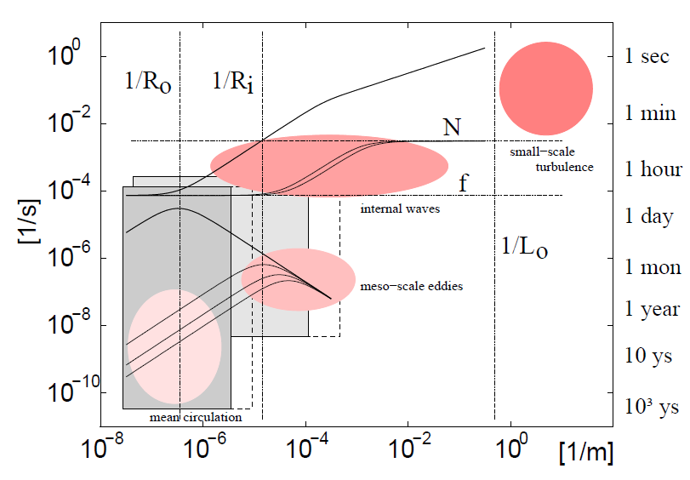
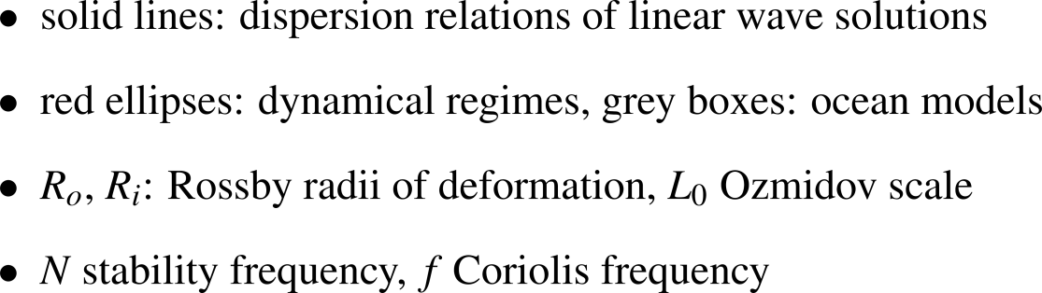
Energy in the ocean
tides, wind
wave breaking
WKB
wave-mean flow
interaction
lee waves
mixing

Slide 3



IDEMIX
IDEMIX 1
bclinic tides and NIW
forcing: tides, NIW
nonlinear wave interactions
propagation
dissipation
ω
N
^{up}
^{down}
dissipation
M2
f
m
- m_{c}
m = 0
m_{c}
local energy of continuum
Dirk Olbers and Carsten Eden : A global model for the diapycnal diffusivity induced by internal gravity waves . JPO 2013
Carsten Eden and Dirk Olbers: An energy compartment model for propagation, non-linear interaction and dissipation of internal gravity waves. JPO 2014
Carsten Eden, Lars Czeschel and Dirk Olbers: Towards energetically consistent ocean models. JPO 2014

Slide 4
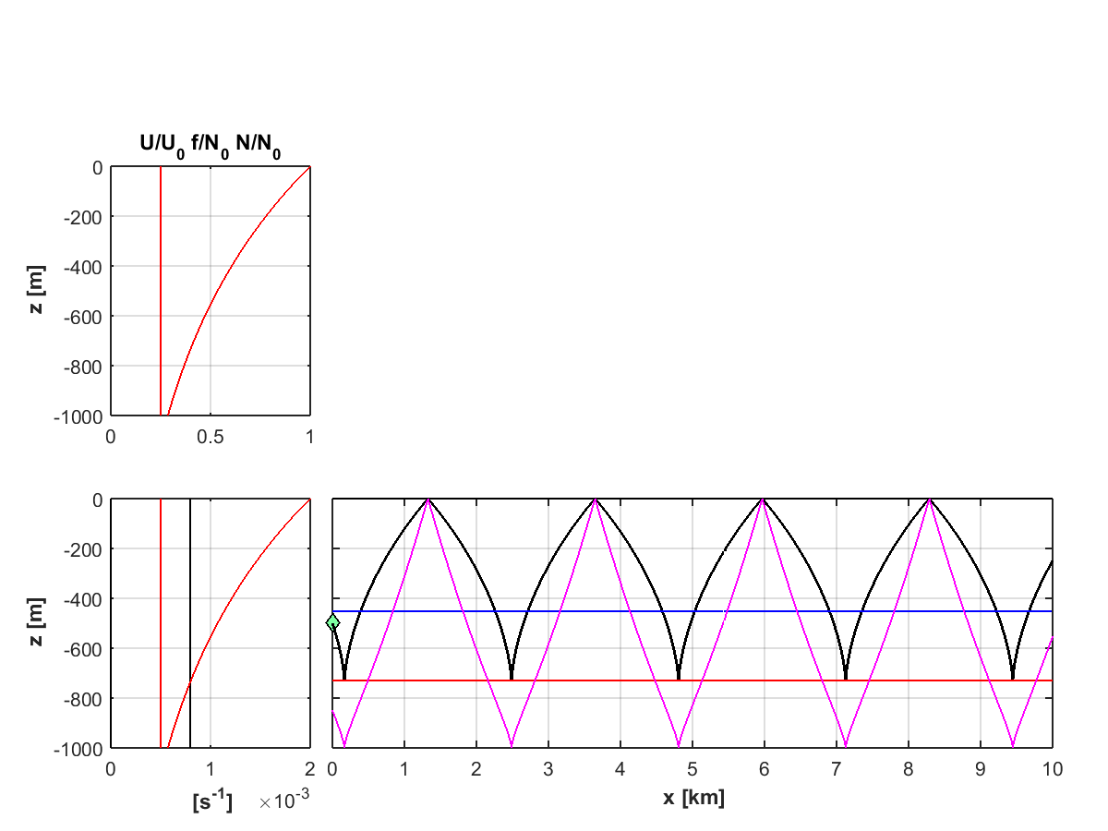


Rays
no mean flow
Pol
Notes:
4

Slide 5
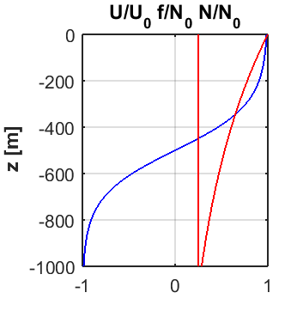

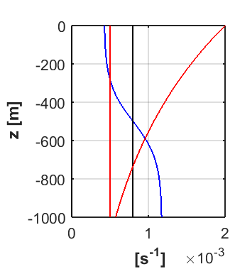
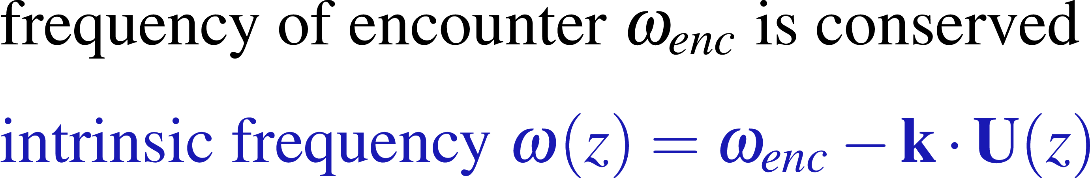
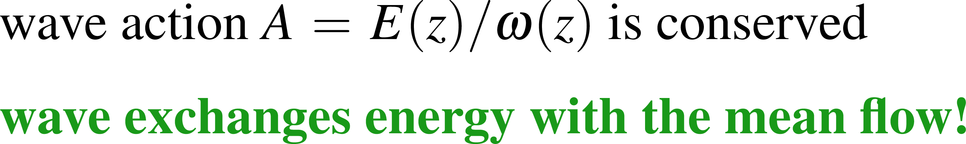
Rays
with mean flow
Pol
Notes:
5

Slide 6
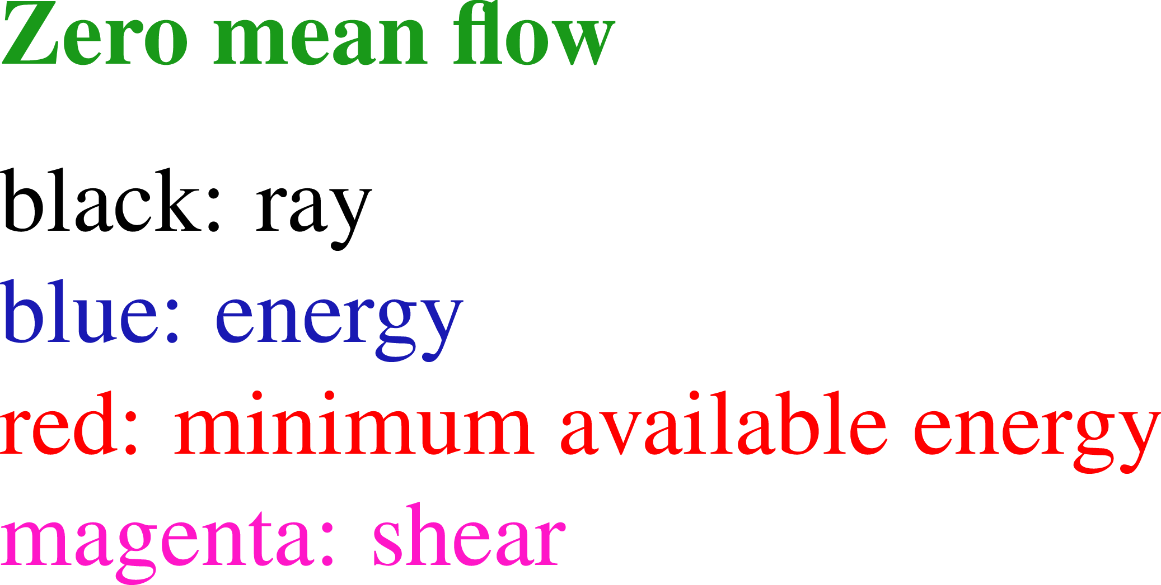

Rays – examples

Slide 7
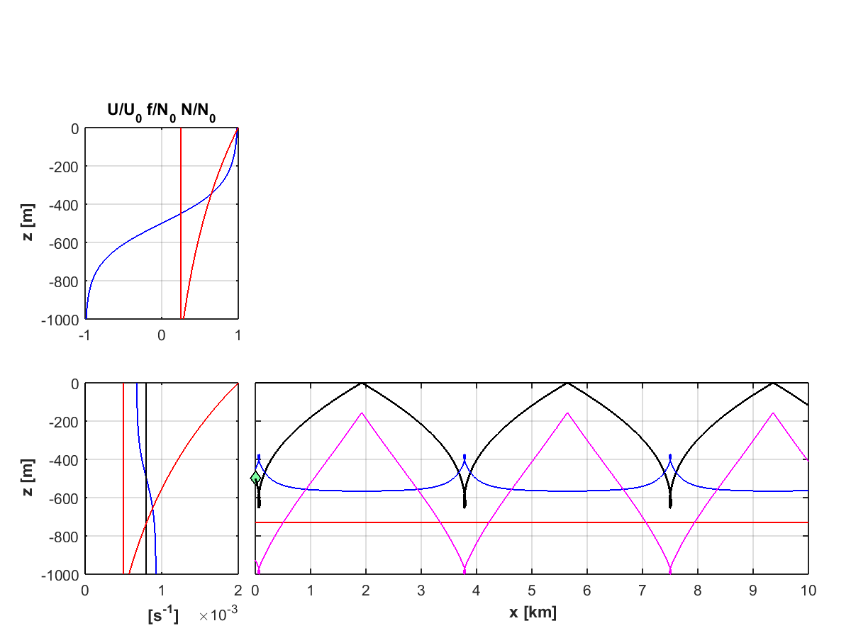
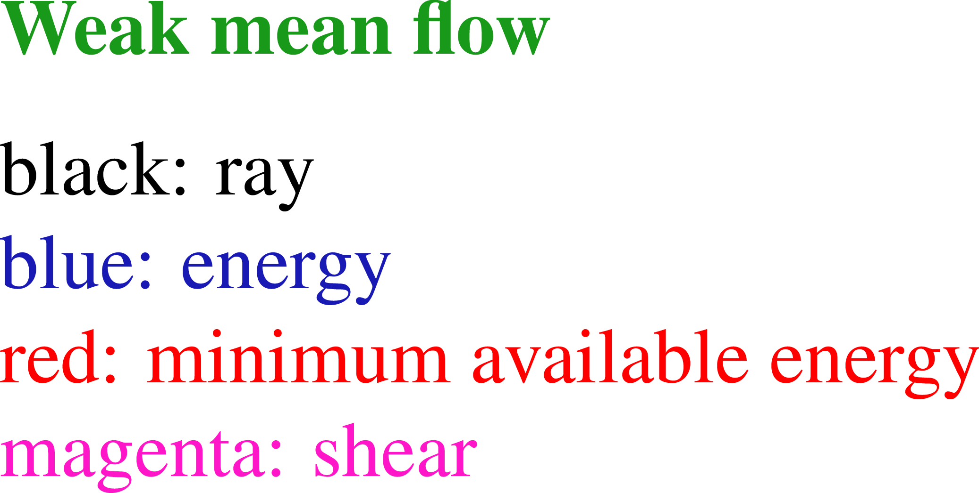
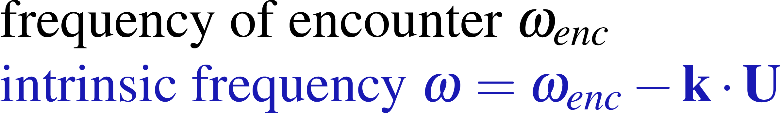
Rays – examples

Slide 8
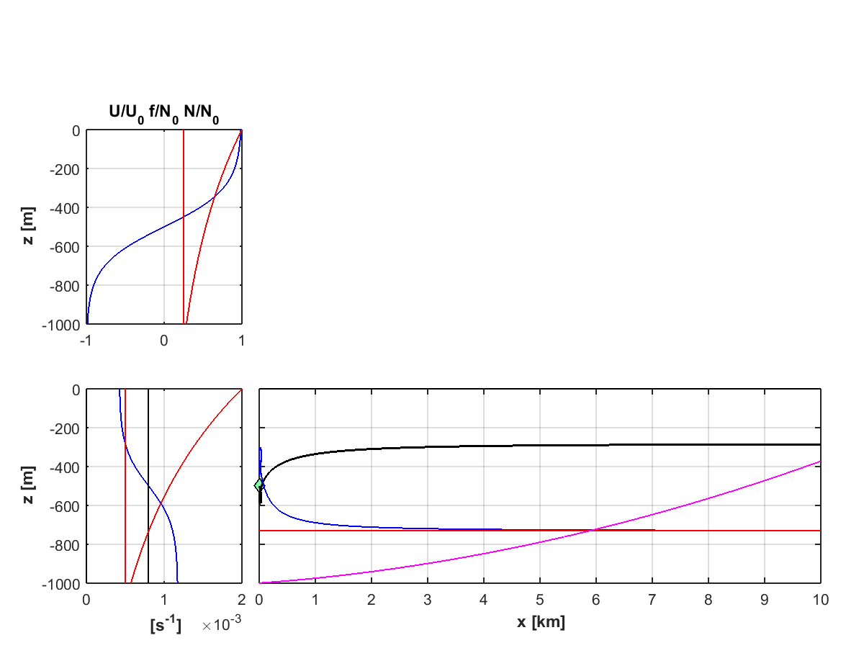
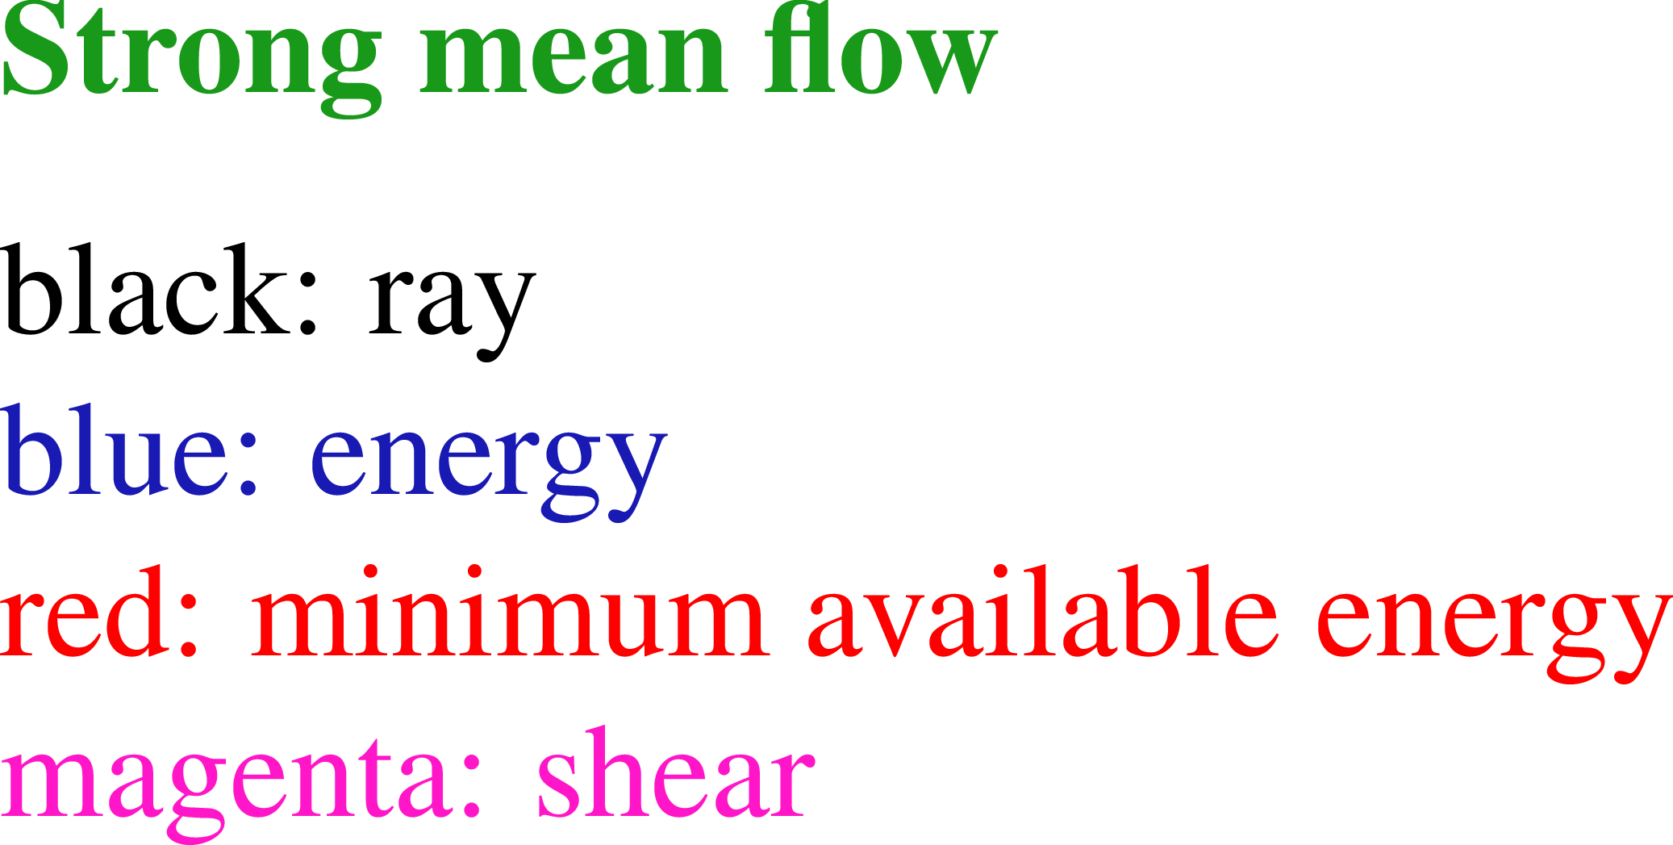
Rays – examples

Slide 9
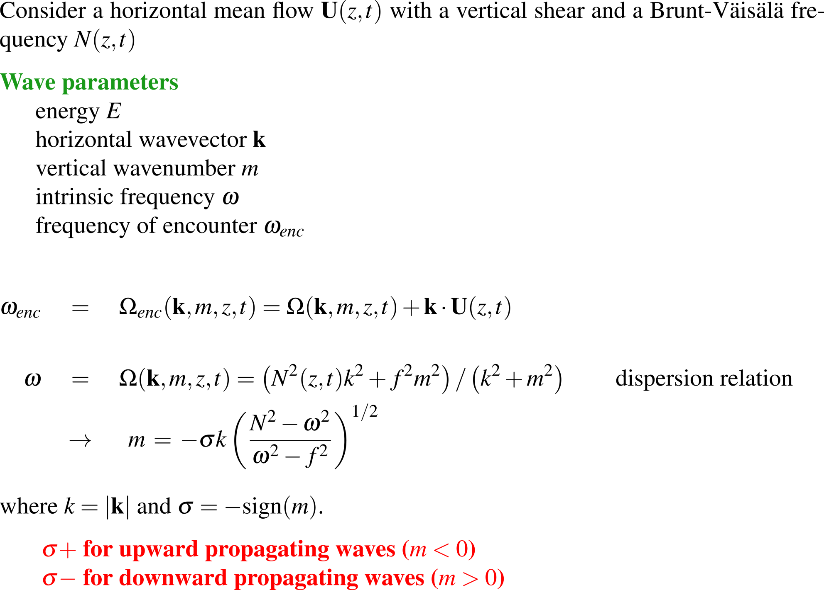
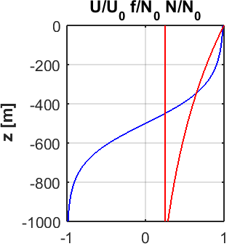
Rays – WKB theory

Slide 10
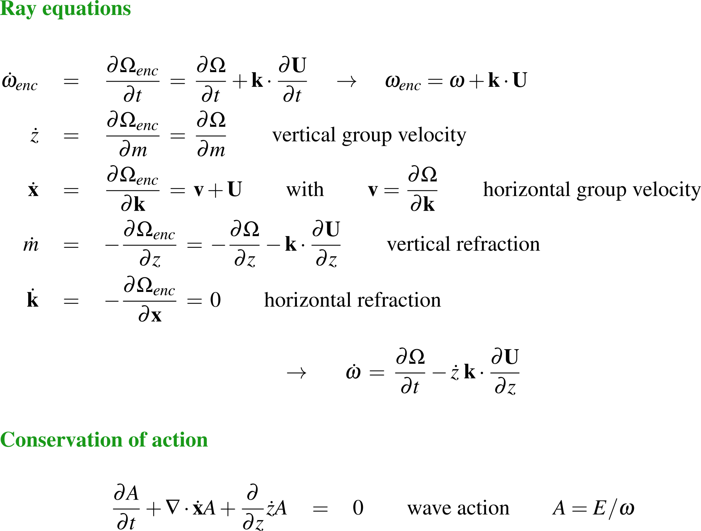
Rays – WKB theory

Slide 11
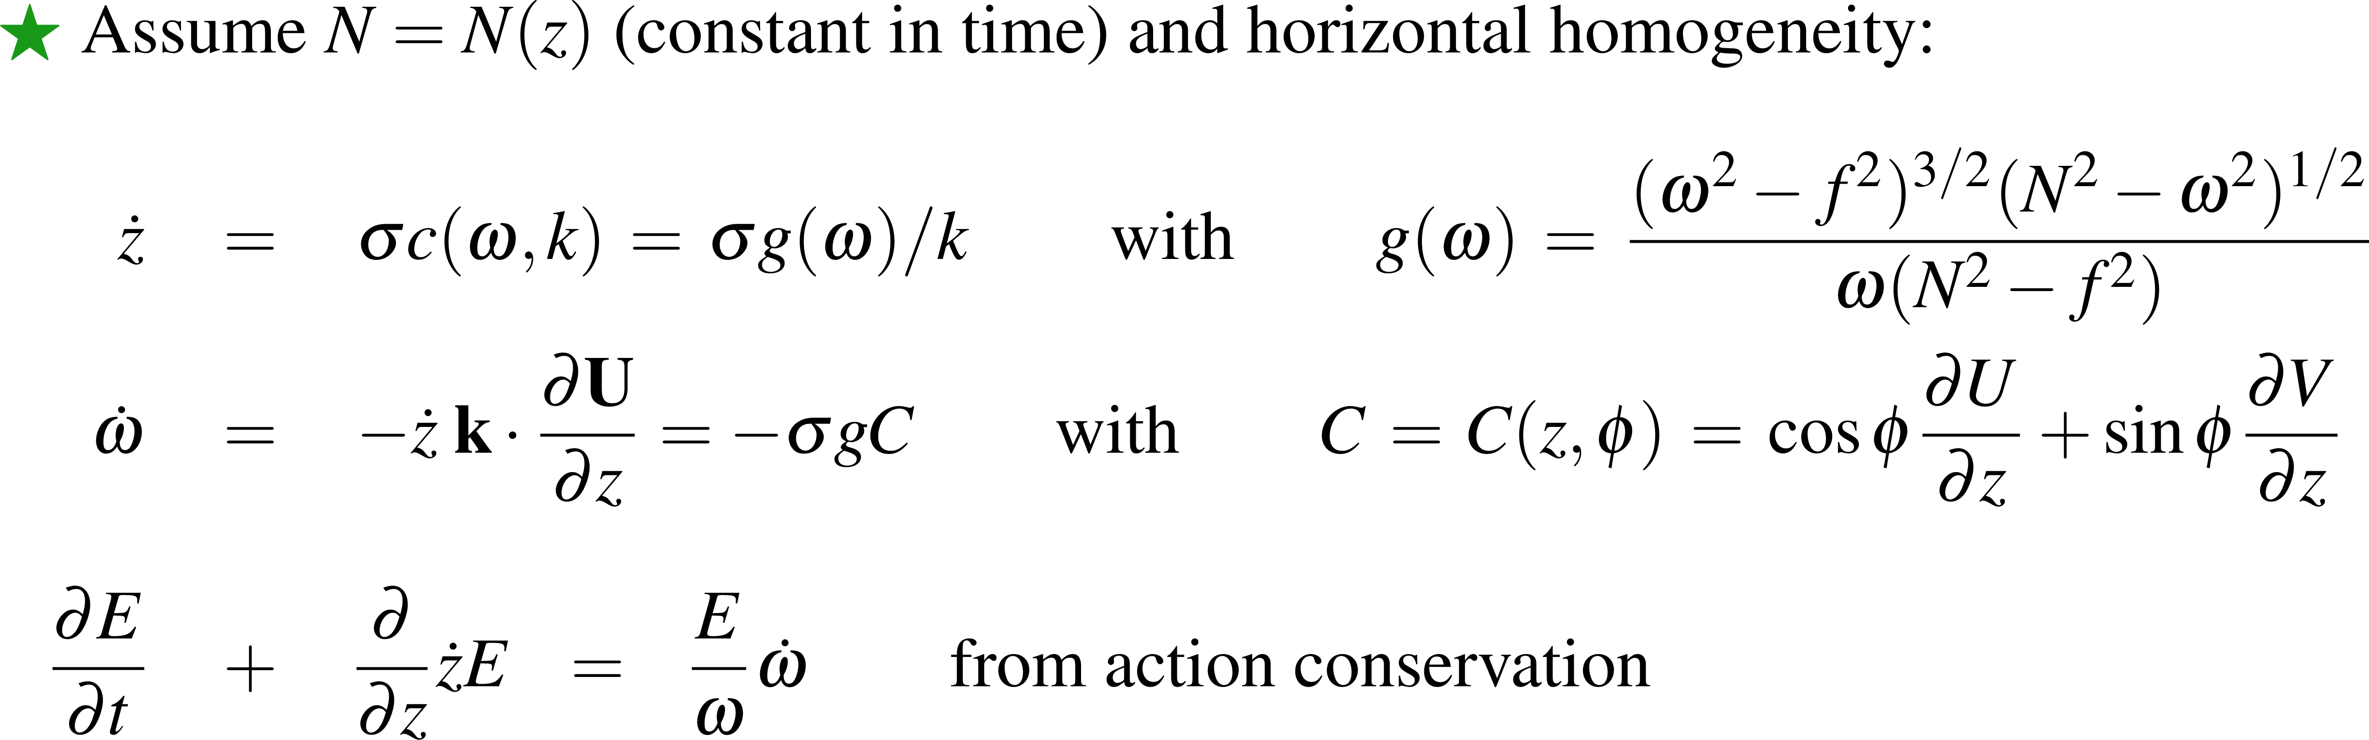
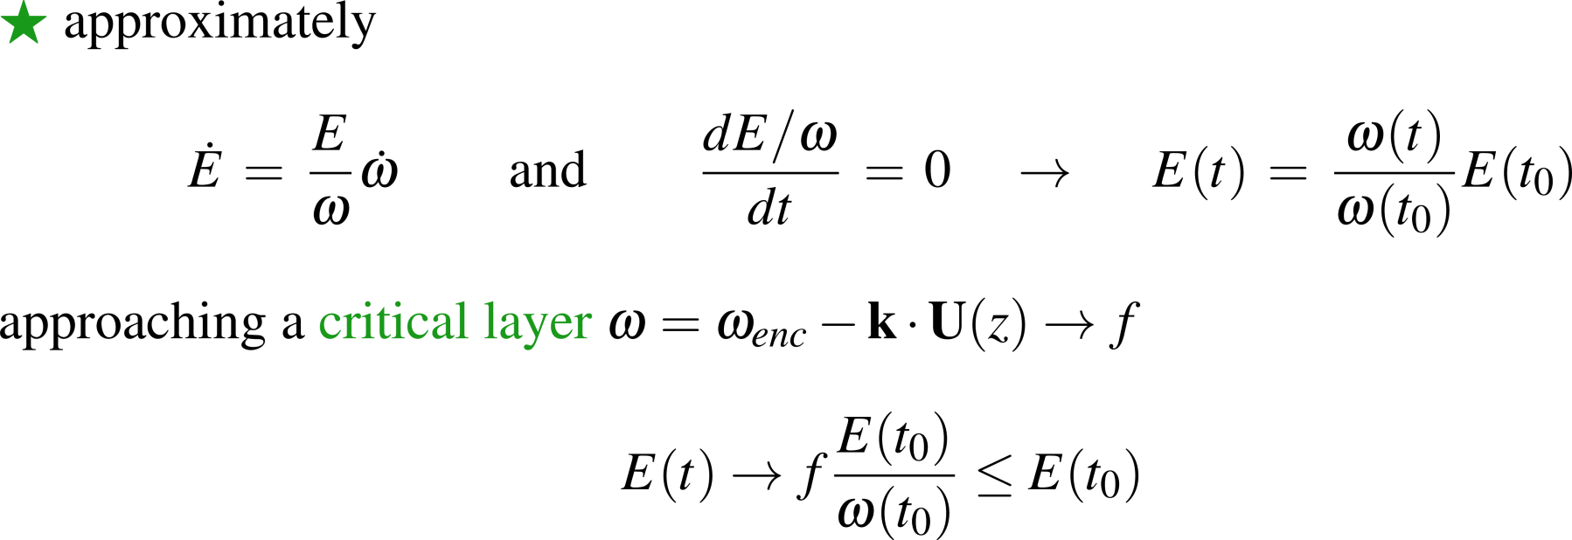
Rays – WKB theory

Slide 12
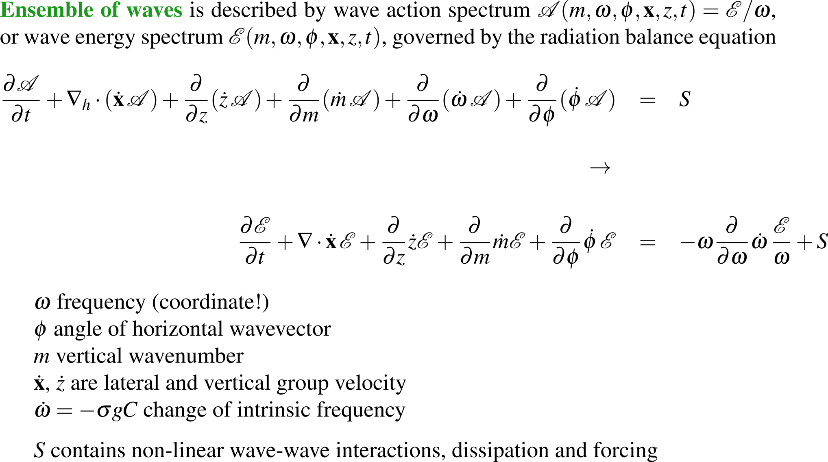
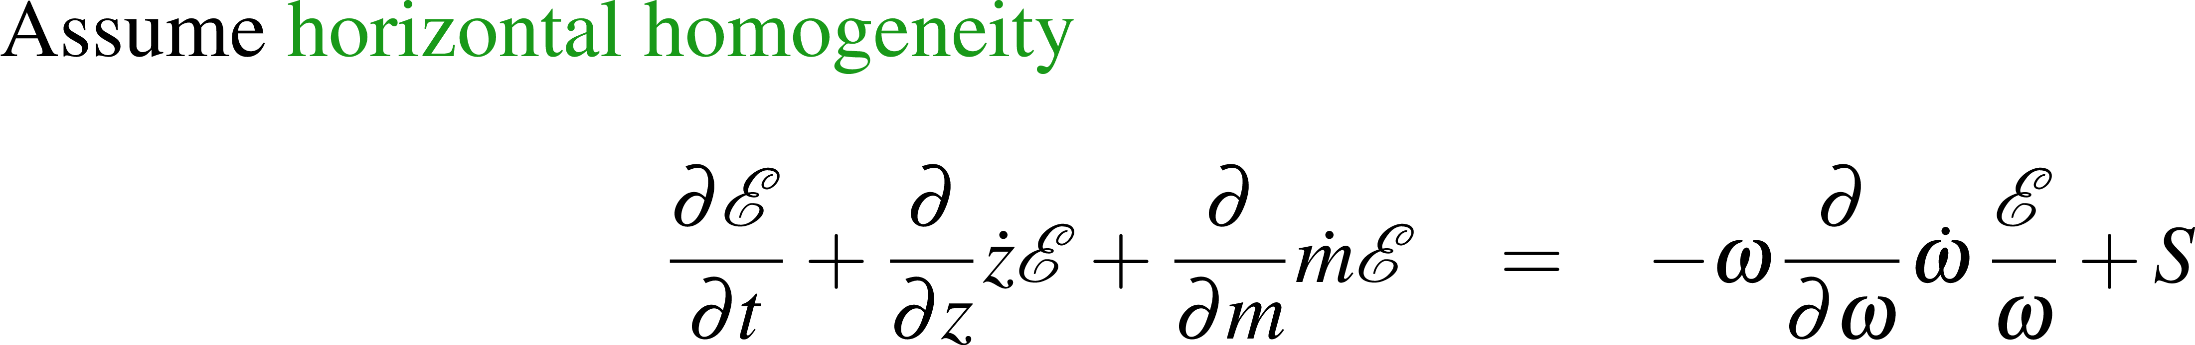
Radiation balance equation

Slide 13
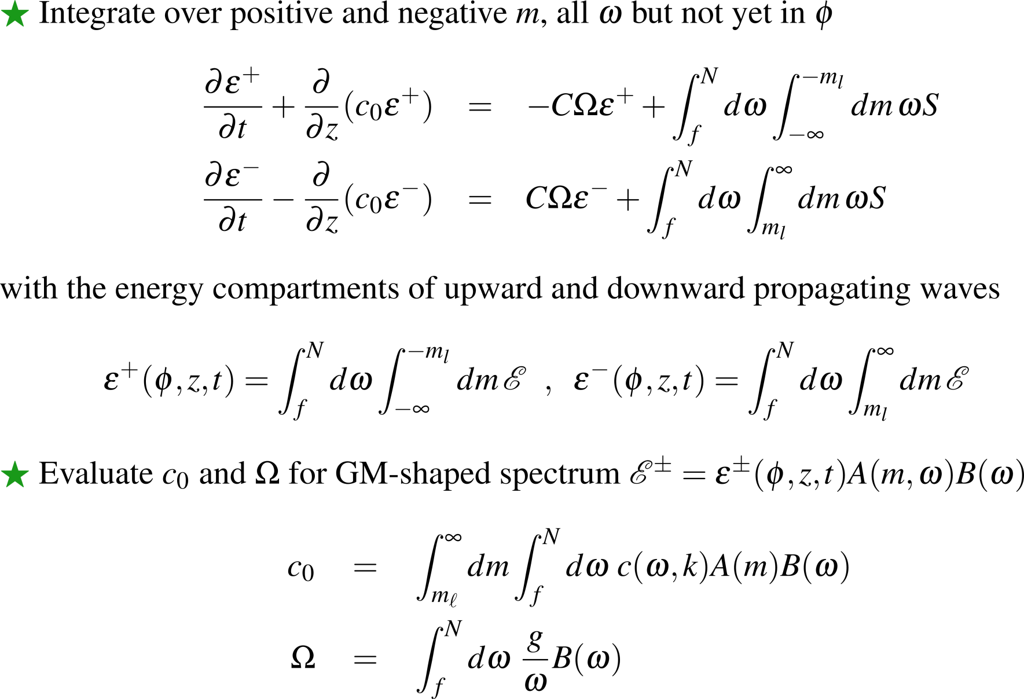
Radiation balance equation – IDEMIX

Slide 14
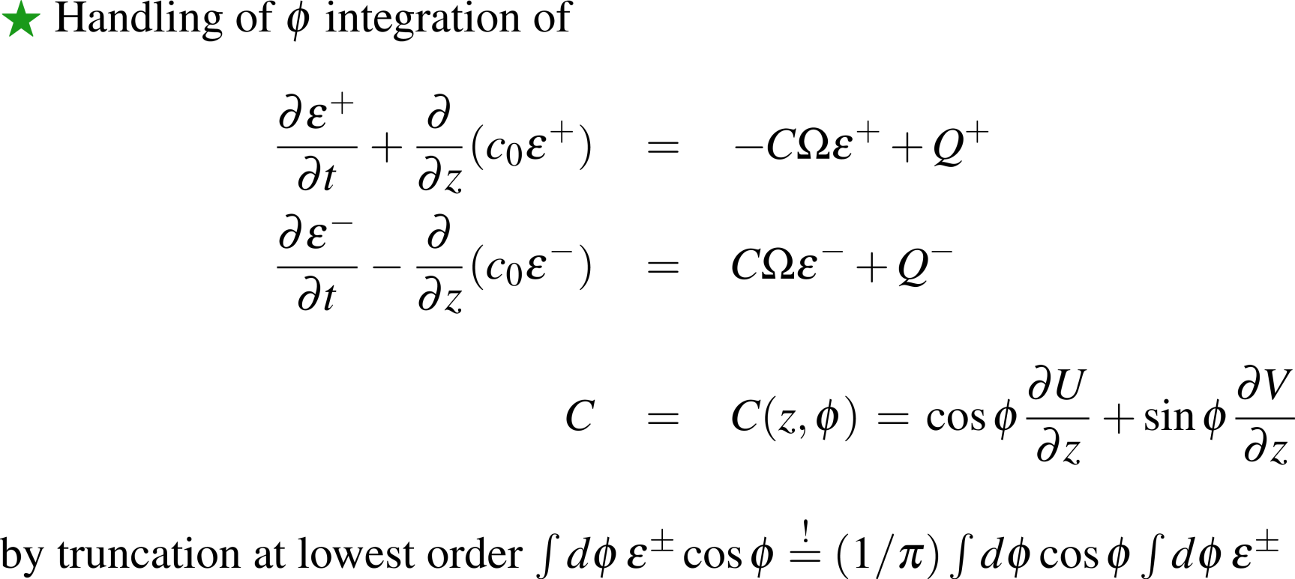
Radiation balance equation – IDEMIX

Slide 15
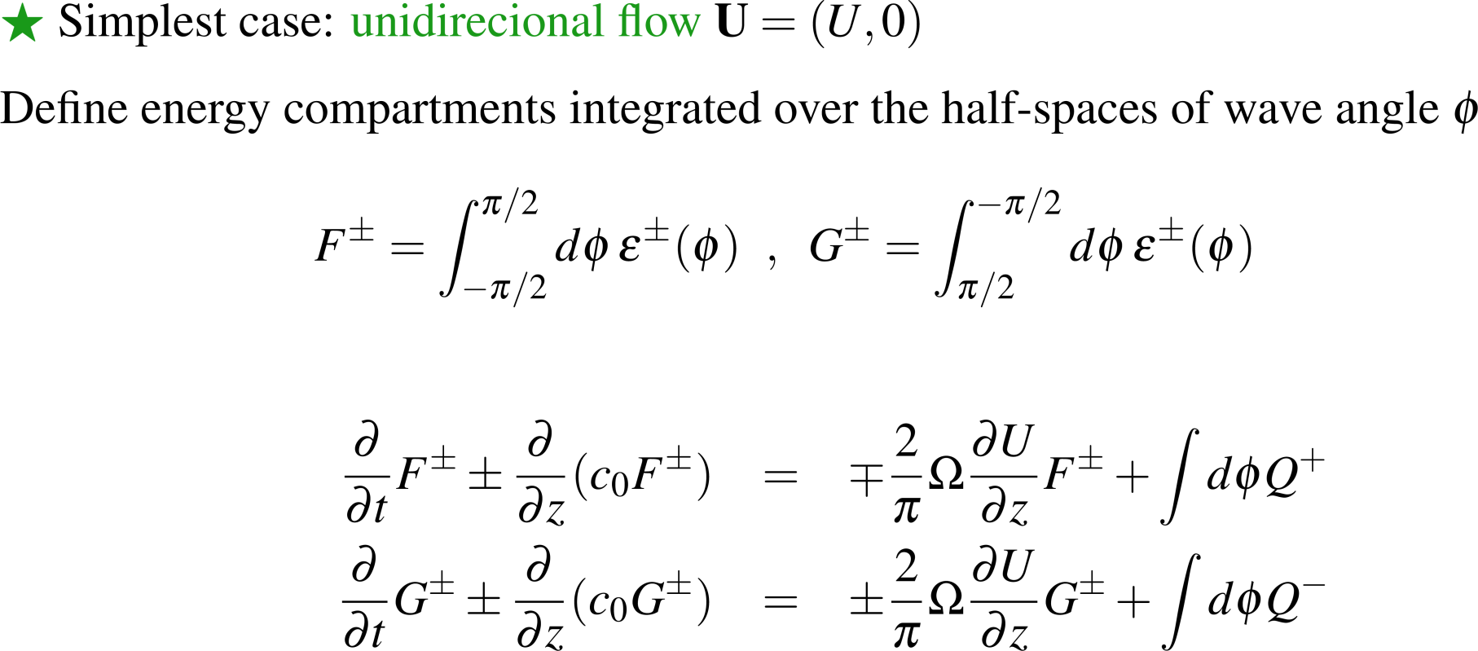
Radiation balance equation – IDEMIX

Slide 16
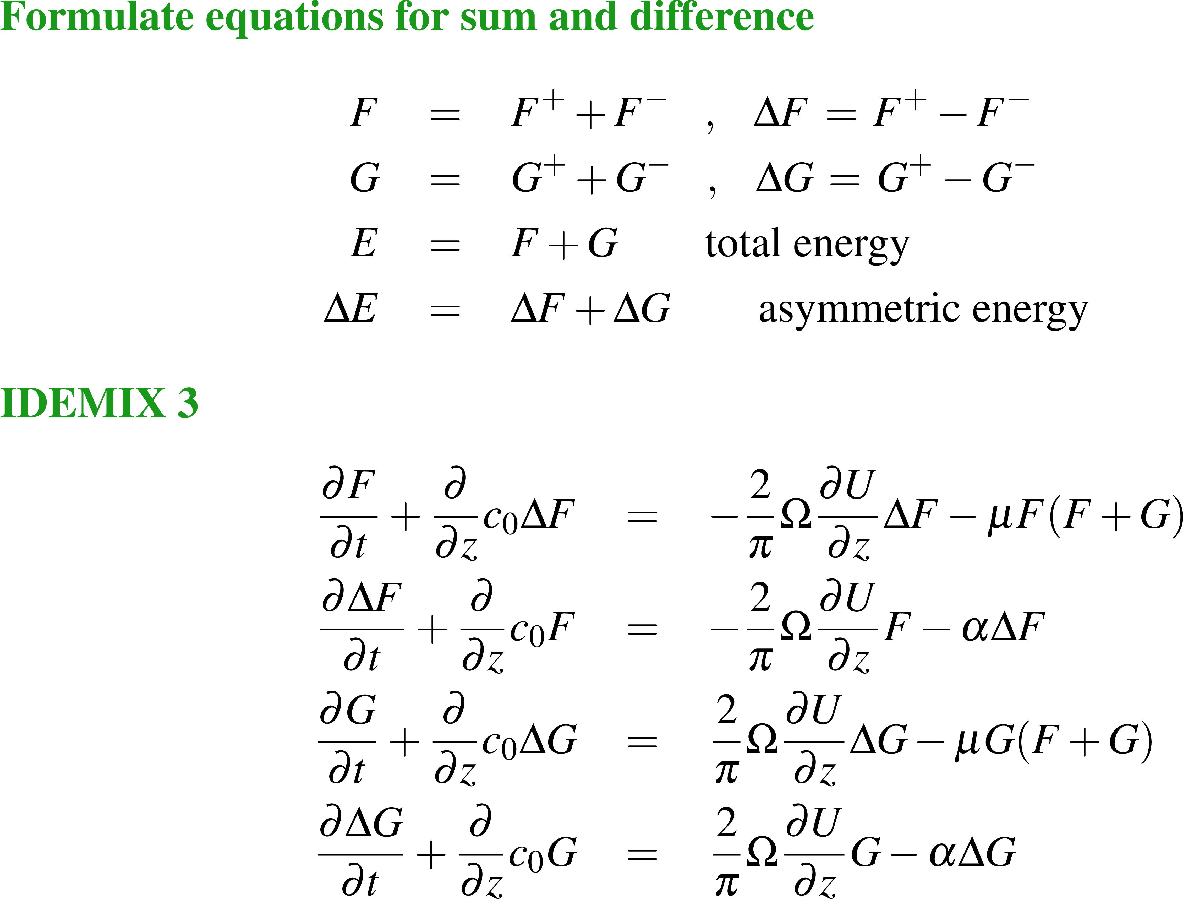
Radiation balance equation – IDEMIX
IDEMIX 3

Slide 17
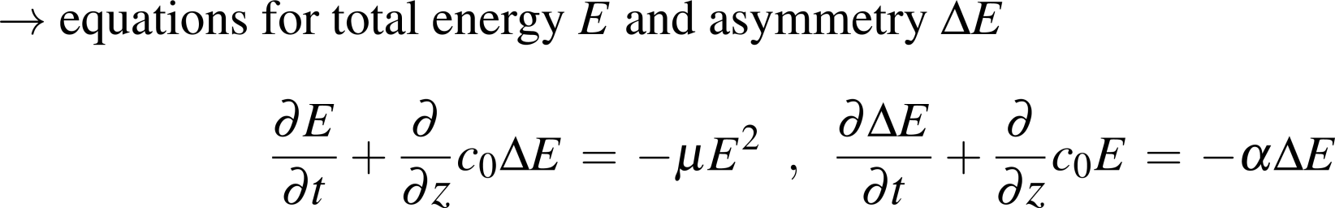
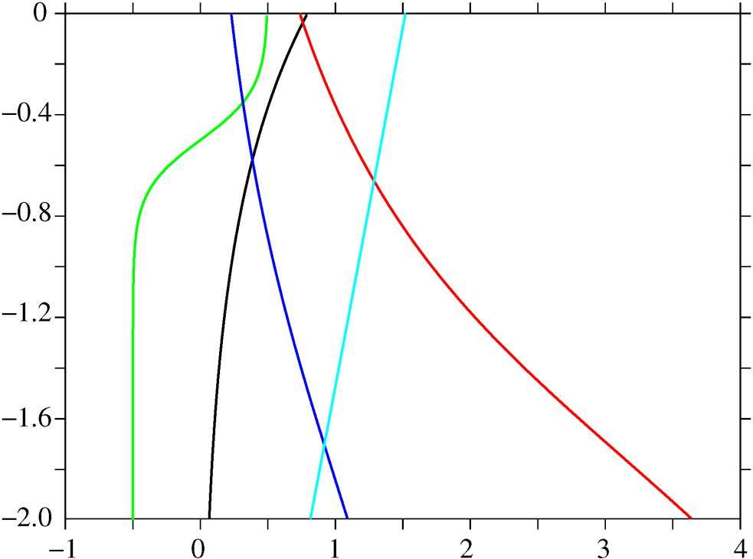
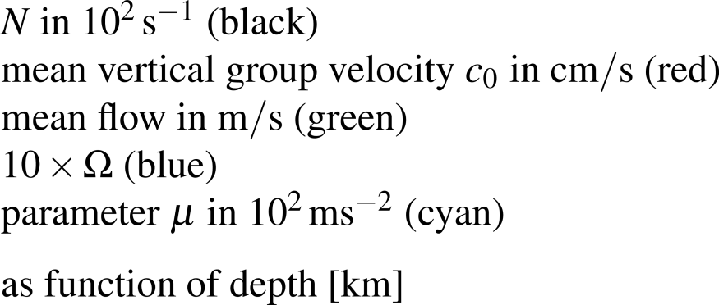
1D example of IDEMIX
no mean flow

Slide 18
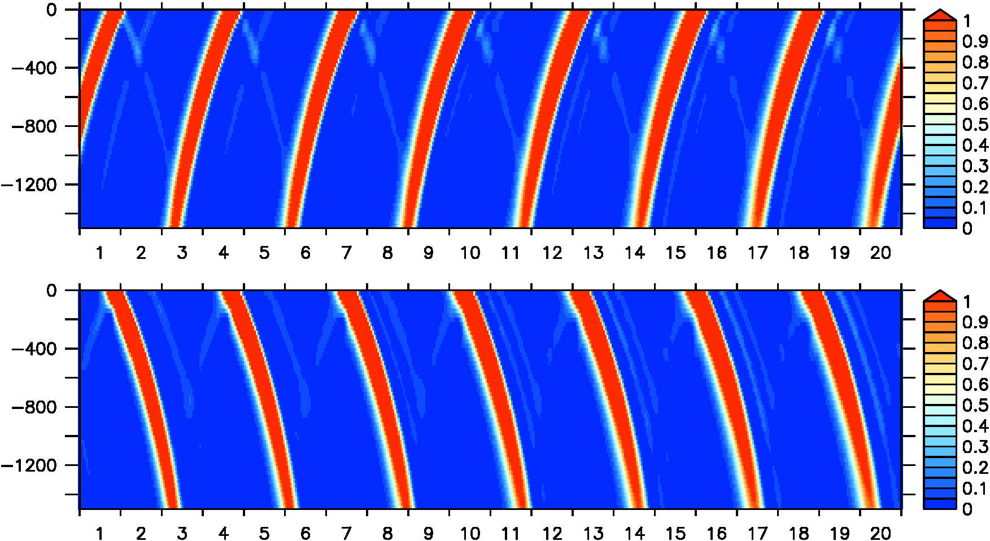

1D example of IDEMIX without scattering and dissipation
no mean flow

Slide 19
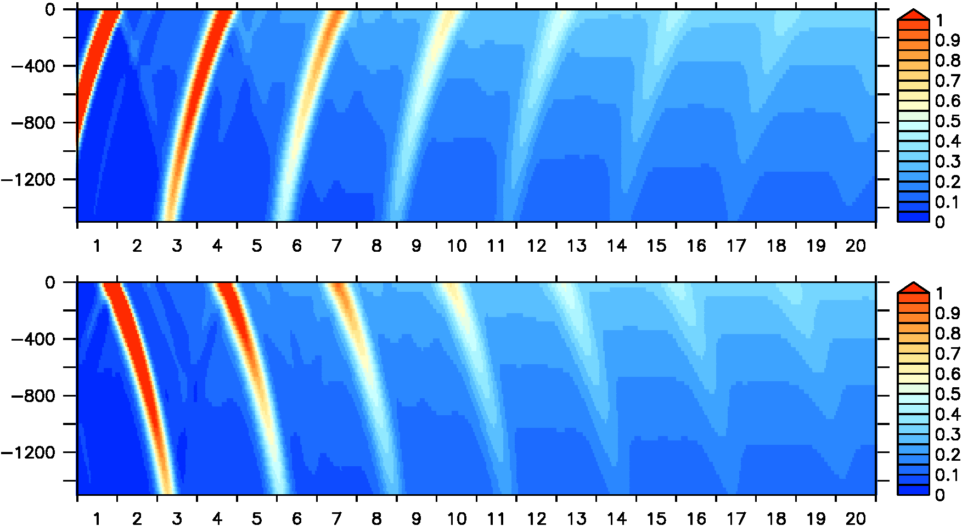
1D example of IDEMIX with scattering and without dissipation
no mean flow

Slide 20
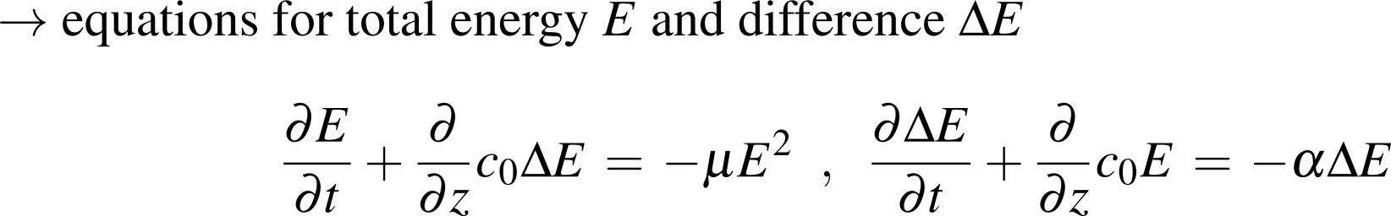
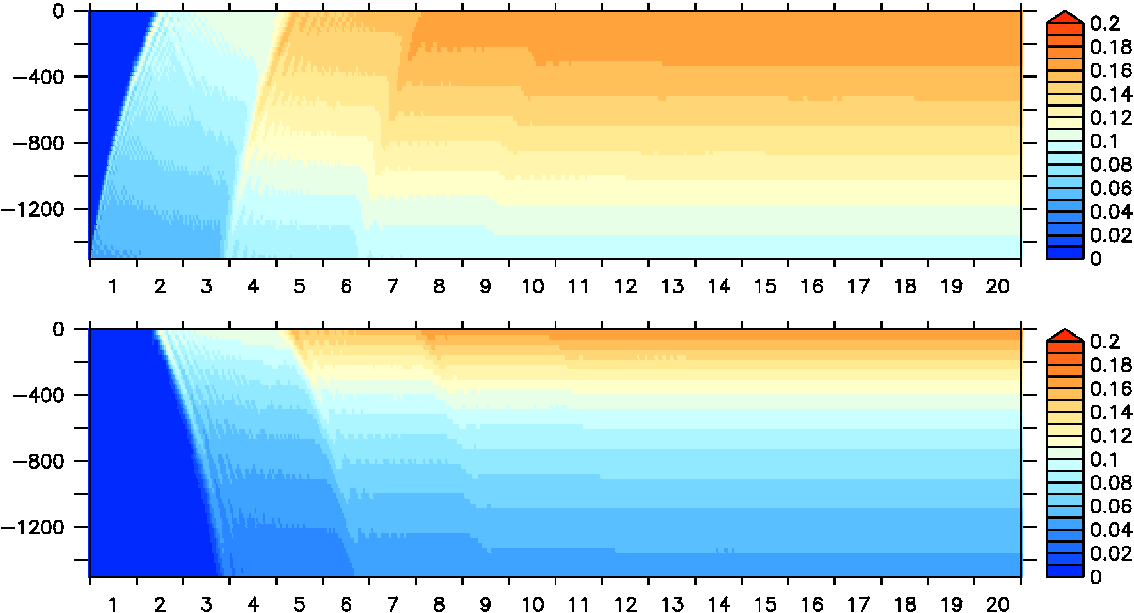
1D example of IDEMIX with scattering, forcing and dissipation
no mean flow

Slide 21
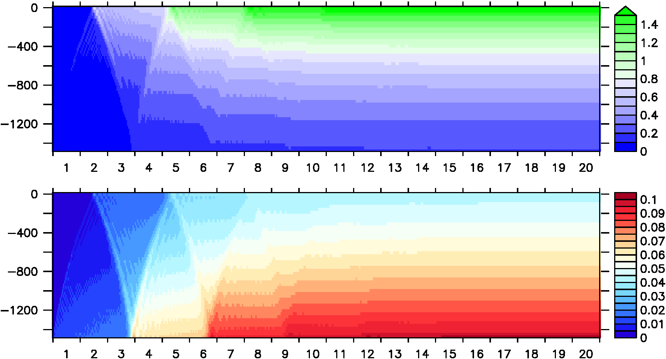
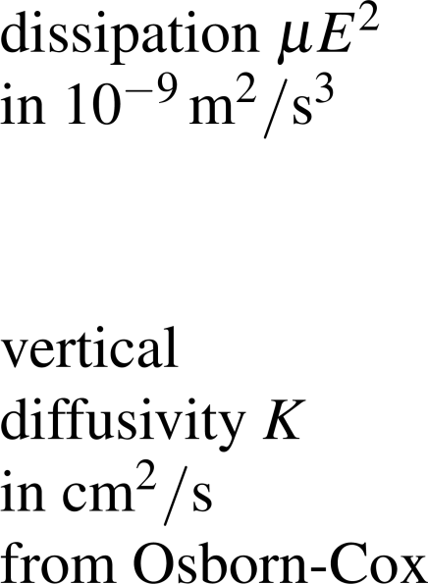
1D example of IDEMIX with scattering, forcing and dissipation
no mean flow

Slide 22
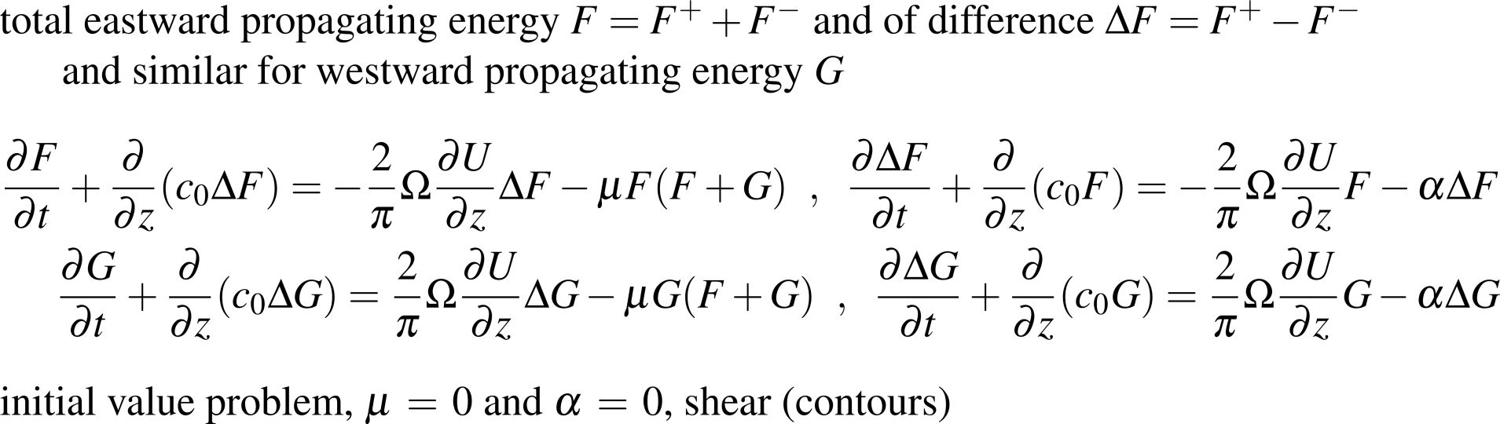
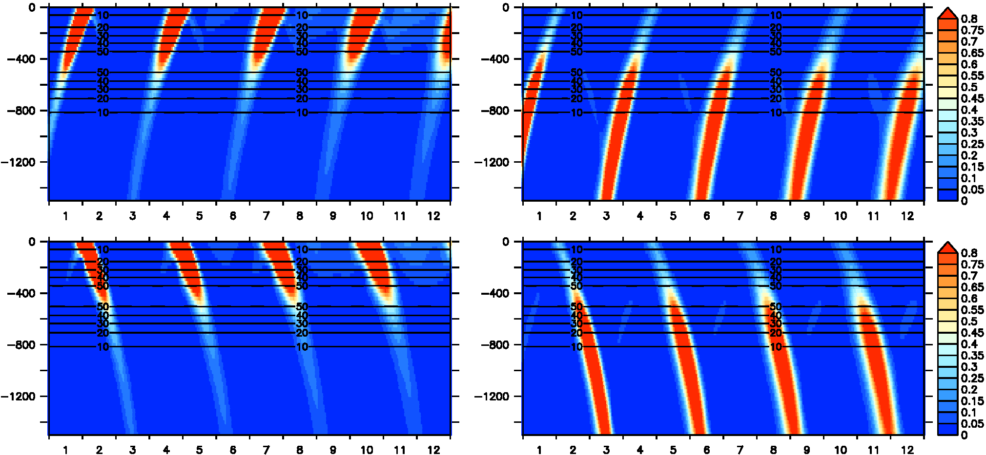


1D example of IDEMIX without scattering and dissipation
with mean flow

Slide 23
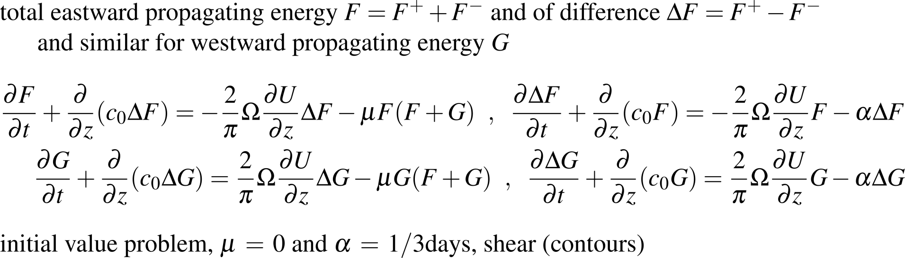
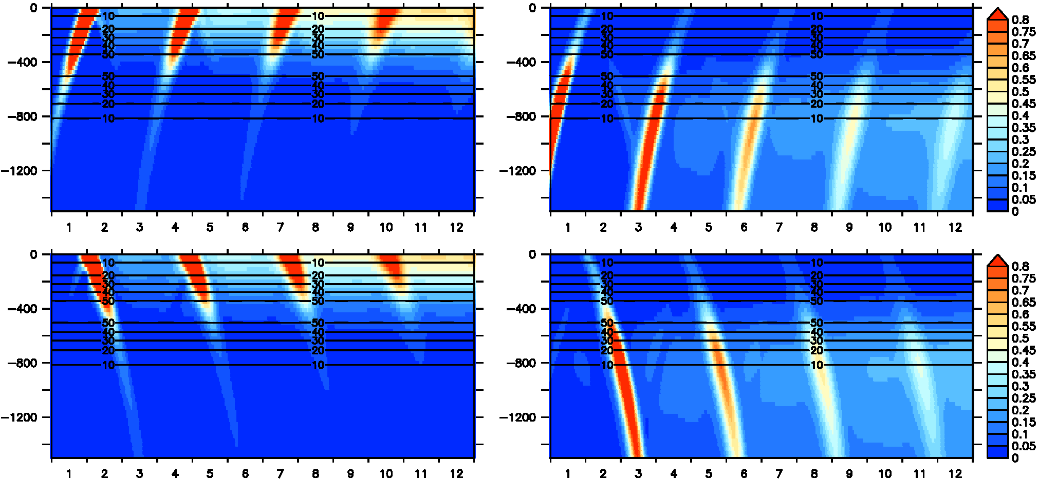
1D example of IDEMIX with scattering and without dissipation
with mean flow

Slide 24
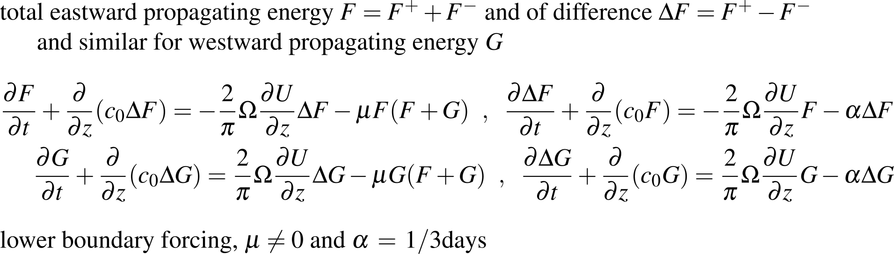
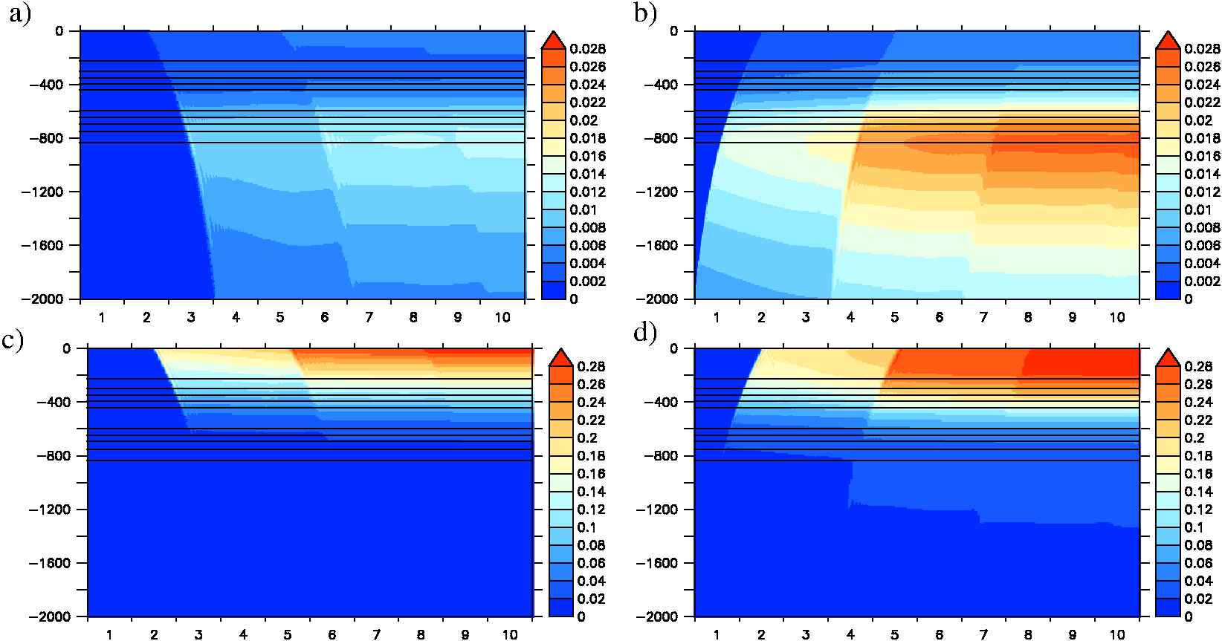


1D example of IDEMIX with scattering and with dissipation
with mean flow

Slide 25
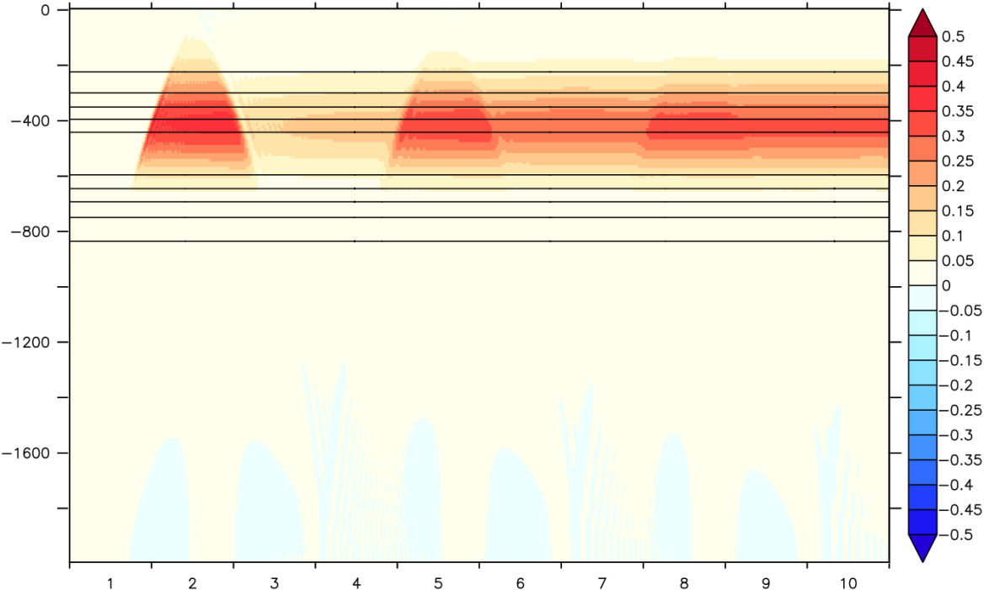
1D example of IDEMIX with scattering and with dissipation
with mean flow

Slide 26
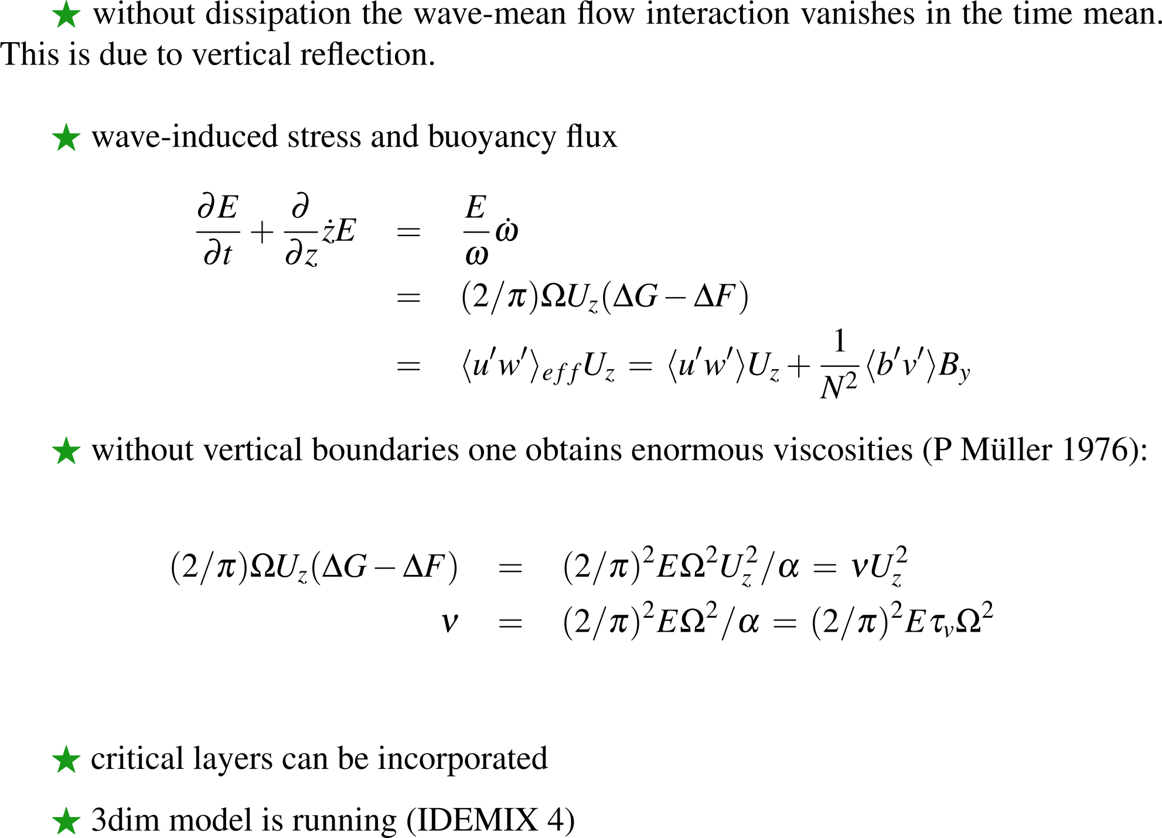
Outlook

Slide 27
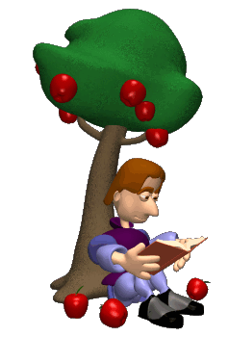

Literature for Internal Waves

Slide 28
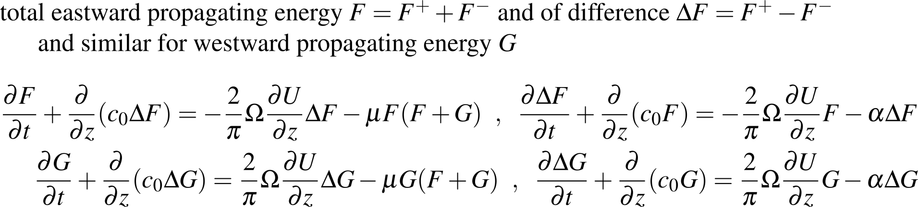
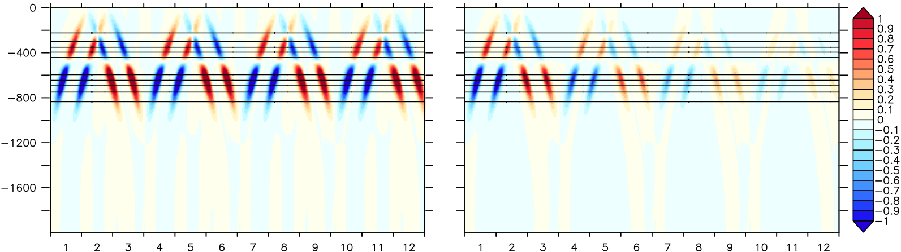
1D example of IDEMIX with scattering and without dissipation
with mean flow

Slide 29
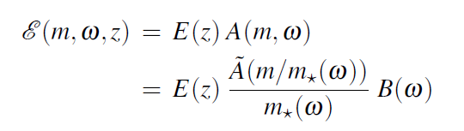
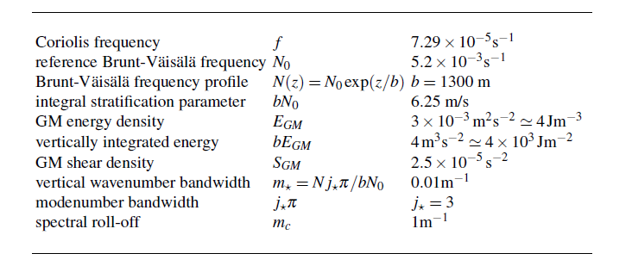
Internal wave kinematics
GM76 spectral model
~ ω⁻²
~ m⁻²
vertical
wavenumber
frequency

