Slide 2

Turbulent Transport in the Atmospheric and Oceanic Mixed Layer Under Convective Conditions Studied with Large-Eddy Simulation
Siegfried Raasch
Institut für Meteorologie und Klimatologie
Leibniz Universität Hannover

Slide 3
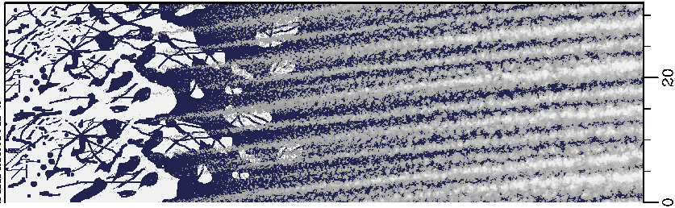
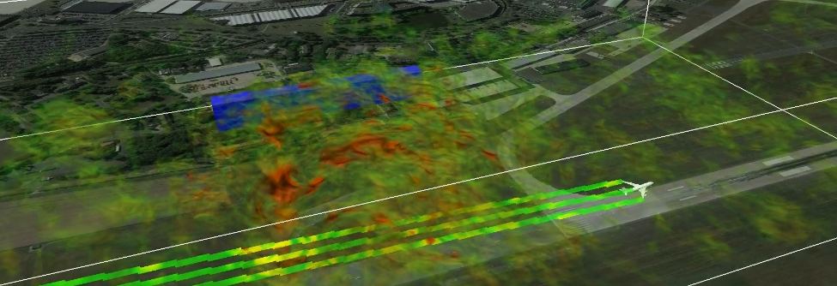
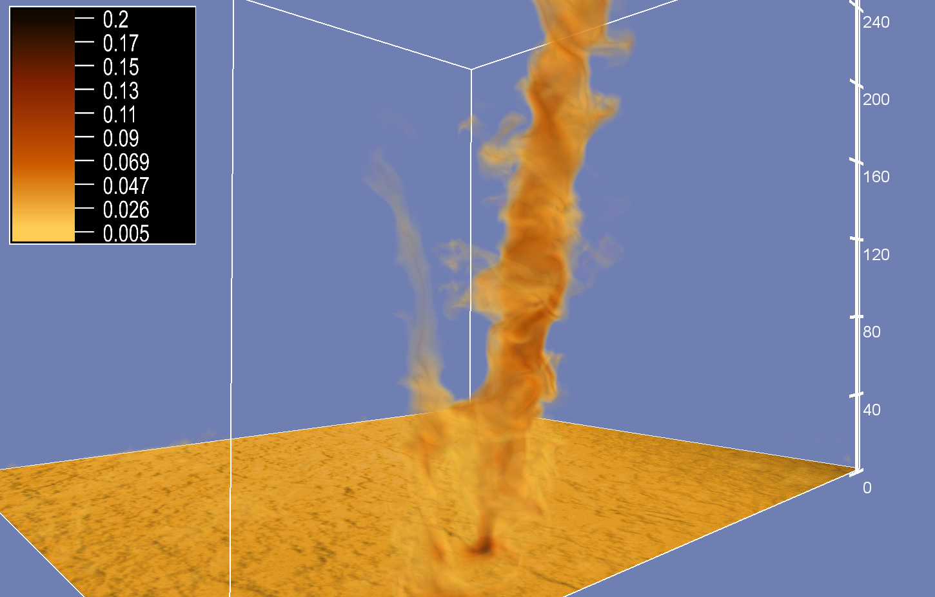
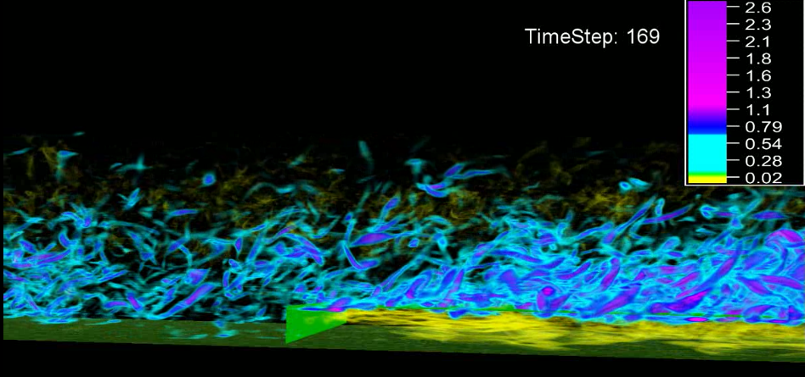
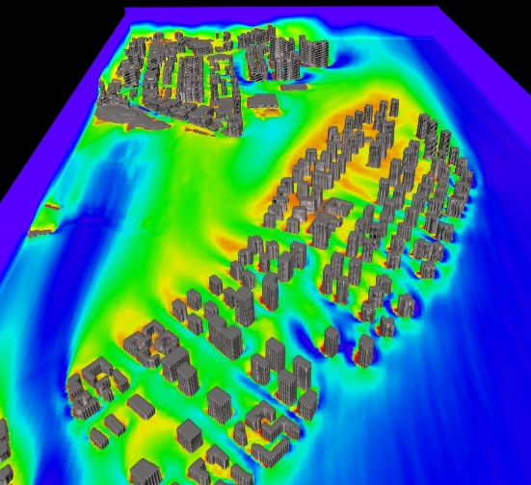
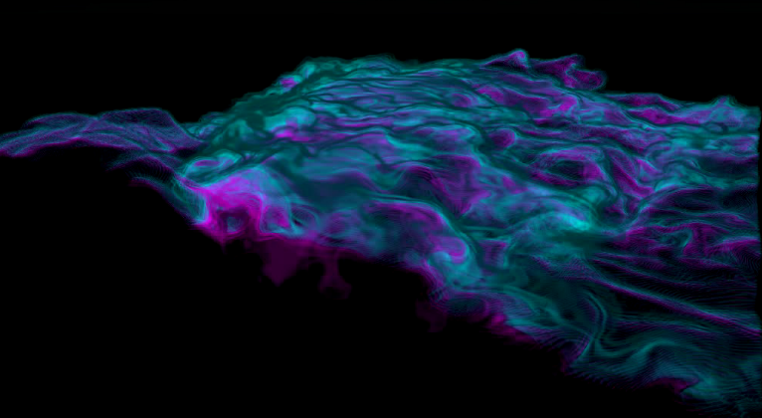
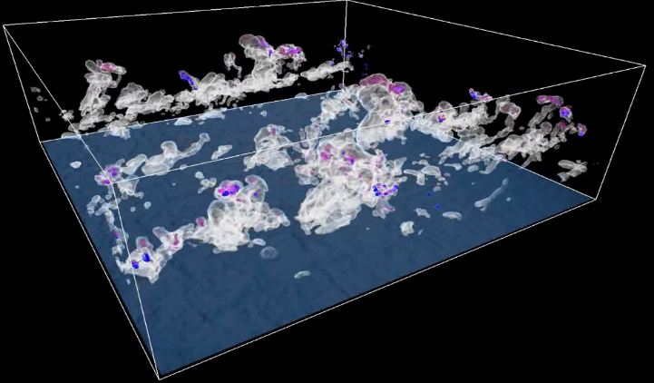
LES applications at IMUK
roll convection
turbulence effects on aircrafts
dust devils
canopy layer effects
urban canopy layer
entrainment
cloud droplet growth

Slide 4
Ocean-LES applications at
Yonsei University, Seoul
Noh, Y., W.-G. Cheon and S. Raasch (2003): The role of preconditioning in the evolution of open-ocean deep convection, J. Phys. Oceanogr., 33, 1145-1166
Noh, Y., H.S. Min and S. Raasch (2004): Large-eddy simulation of the ocean mixed layer: The effects of wave breaking and Langmuir circulation, J. Phys. Oceanogr., 34, 720-735
Min, H.S. and Y. Noh, 2004: Influence of the surface heating on Langmuir circulation. J. Phys. Oceanogr., 34, 2630-2641
Noh, Y., Kang, I.S., Herold, M. and S. Raasch (2006): Large-eddy simulation of particle settling in the ocean mixed layer, Phys. of Fluids, 18, 085109
Noh, Y., G. Goh, S. Raasch and M. Gryschka (2009): Formation of a diurnal thermocline in the ocean mixed layer simulated by LES, J. Phys. Oceanogr., 39, 1244-1257
Noh, Y., G. Goh and S. Raasch (2010): Examination of the mixed layer deepening process during convection using LES, J. Phys. Oceanogr., 40, 2189-2195
Noh, Y, G. Goh and S. Raasch (2011): Influence of Langmuir Circulation on the Deepening of the Wind-Mixed Layer, J. Phys. Oceanogr., 41, 472-484

Slide 5
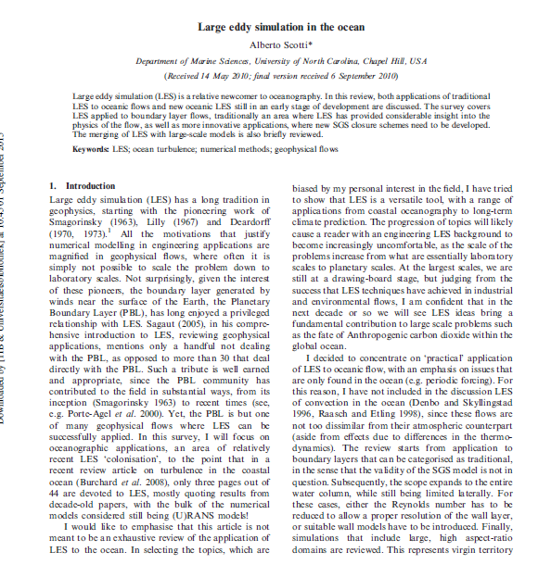

Slide 6
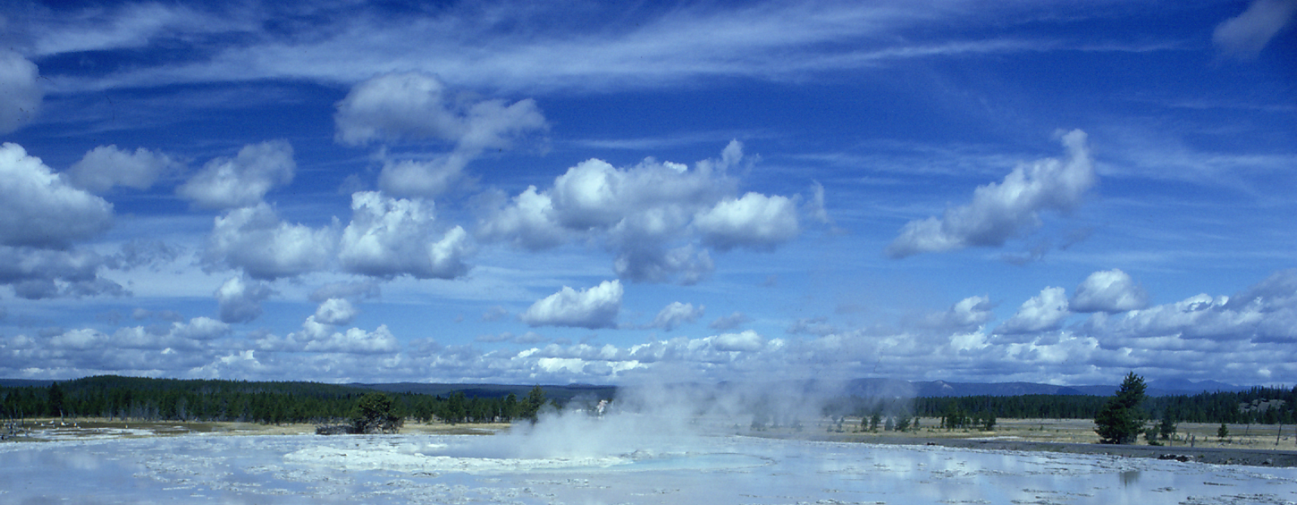
3D-turbulence characteristics
Energy production and dissipation on different scales
  Large scales (L): shear and buoyant production
  Small scales (η): viscous dissipation
Large eddies: 10³ m, 1 h L
Small eddies: 10⁻³ m, 0.1 s η
Garratt (1992)

Slide 7
Turbulence characteristics
Number of gridpoints for a 3D simulation of turbulence:
Turbulence simulation covering all scales of turbulence is called a Direct Numerical Simulation (DNS).

Slide 8
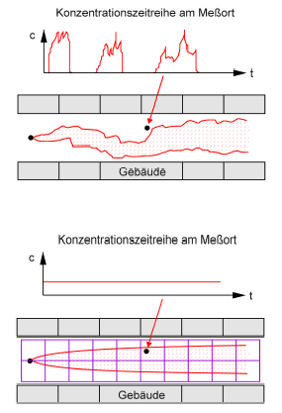
LES Principals
production
inertial subrange
dissipation
z
local concentration time series
Δ
resolved scale
subfilter-scale
fluctuations (u, c)
LES: volume average
x
Δ
building
critical concentration level
local concentration time series
z
smooth result
building
RANS: ensemble average
x
after Schatzmann and Leitl (2001)

Slide 9
LES Principals – Model Equations (I)
Volume averaged NS-equation for a non-divergent, Boussinesq fluid:
volume balance approach
(Schumann, 1975):
transport by large eddies
transport by small eddies
subgrid-scale fluctuations (subgrid scale, SGS)
volume average (resolved scale)

Slide 10
Short Introduction to LES (III)
LES SGS-turbulence parameterization (after Deardorff):

Slide 11

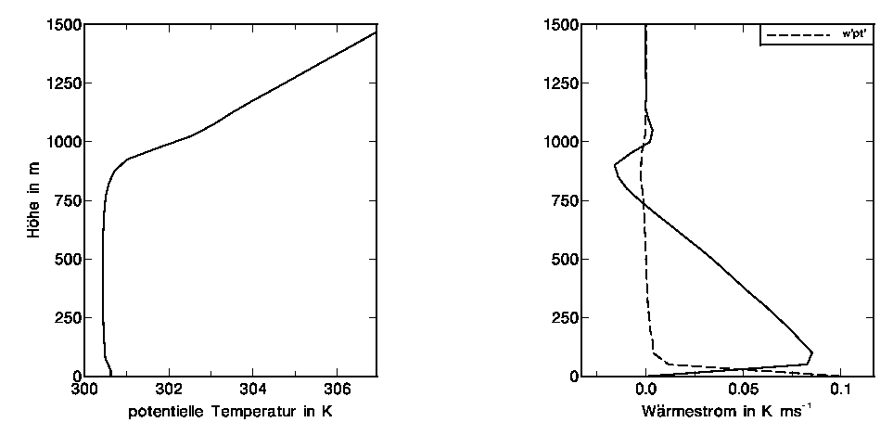
A Simple Example:
Convection Above a Homogeneous Surface
horizontally averaged profiles of a typical convective atmospheric boundary layer as simulated by LES
SGS
inversion
entrainment zone
height in m
mixed layer
w´θ´
parameterized
resolved
potential temperature in K
Sensible heatflux in K ms⁻¹

Slide 12
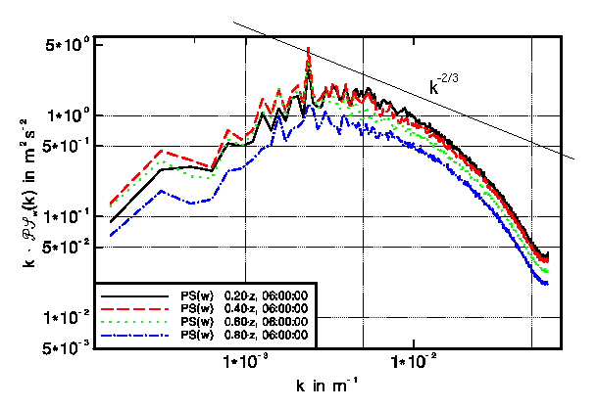
A Simple Example:
Convection Above a Homogeneous Surface
spectral energy distribution

Slide 13
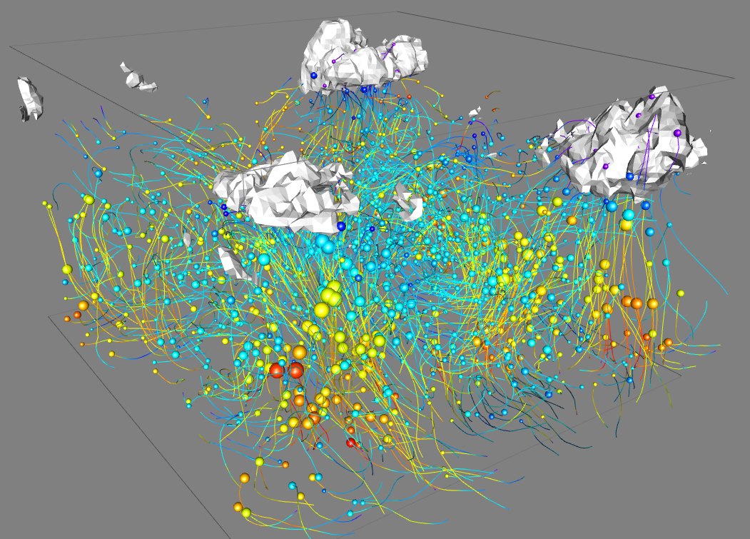
A Simple Example:
Convection Above a Homogeneous Surface
LES-setup:
homogeneously heated surface, temperature inversion at z = 800 m,
domain size: 2 * 2 km², Δ = 50 m
cyclic horizontal boundary conditions
particles = passive tracers
colour ~ buoyancy: ↑ ↓
diameter ~ |vertical velocity|
isosurface of liquid water content
(cumulus cloud)

Slide 14
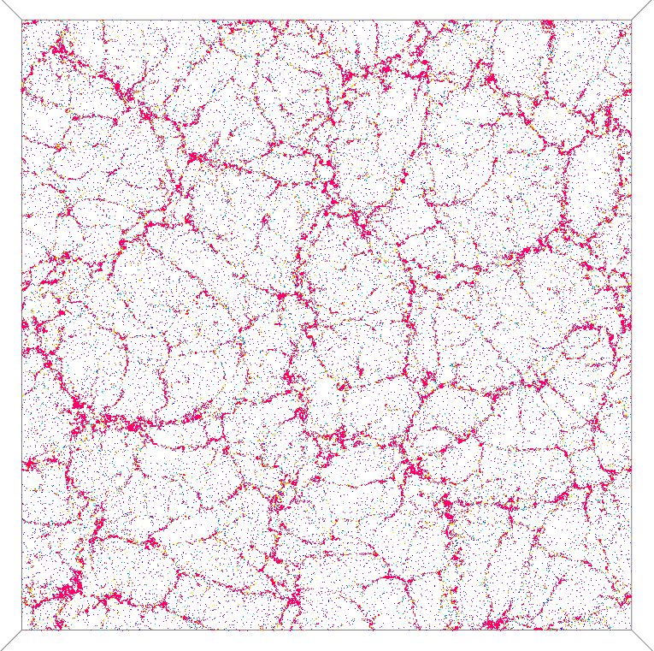
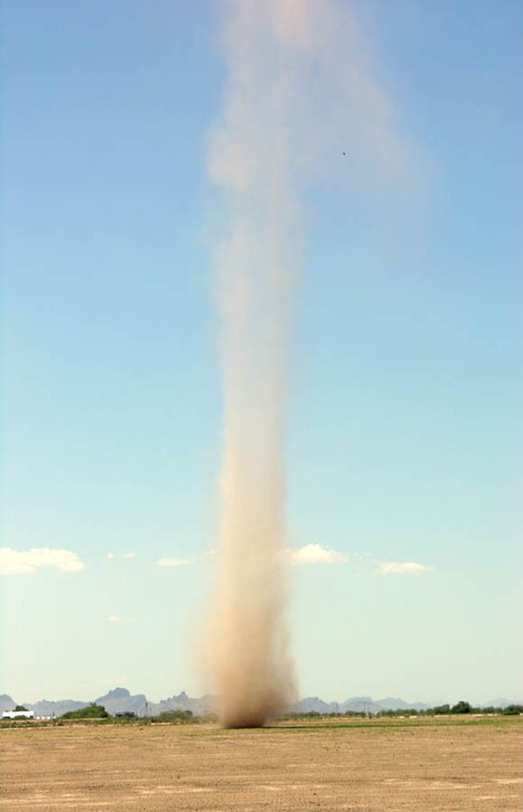
An Advanced Example:
Coherent Structures in a Highly Resolved Convective Boundary layer
domain size: 4 * 4 km²
grid spacing: Δ = 2m
grid points: 10⁹
color: buoyancy: red: pos., blue: neg.
dust devils
horizontal cross section at z = 20m
Raasch and Franke, 2011:
J. Geophys. Res., 116, D1612.

Slide 15
PALM - Overview
PArallelized LES Model
first version 1997, continously developed since then, under GPL
written in FORTRAN 95 / 2003
very high performance and scalability on all state-of-the-art parallel architectures
one code for atmosphere and ocean

Slide 16
PALM – A PArallelized LES Model
Features / Numerics
central finite differences
cartesian staggered grid
topography (cartesian or immersive)
non-cyclic horizontal boundary conditions + turbulent inflow
Runge-Kutta 3rd-order timestep scheme
FFT- or multigrid-method for solving the Poisson-equation
various high order advection schemes available (default: Wicker-Skamarock)
canopy model
for further details see:
http://palm.muk.uni-hannover.de
Maronga et al., 2015: Geosci. Model Dev. Discuss.,
DOI: 10.5194/gmdd-8-1539-2015
cloud physics (two moment scheme after Seifert and Beheng)
embedded complete Lagrangian particle model (dispersion modelling, cloud droplets, graphics)
ocean-version with salinity (can be coupled with atmosphere)
large-scale forcing and nudging
online data analysis, all output in netCDF format

Slide 17
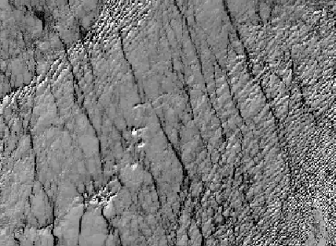
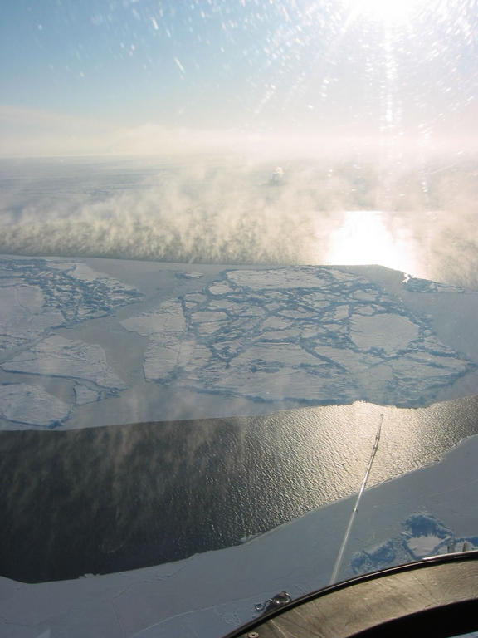
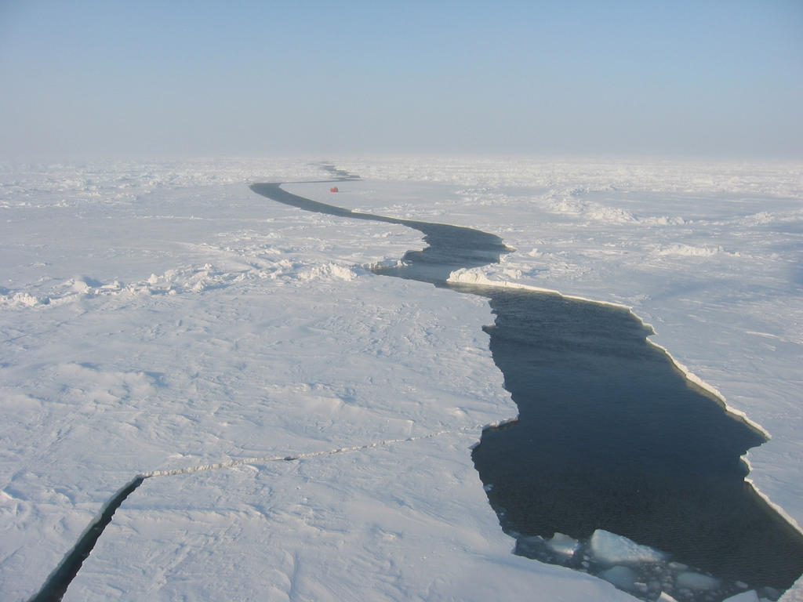
Turbulent Transport Above Leads
sea smoke
2 km
-25 ⁰C
-2 ⁰C
1 km

Slide 18
Boundary Layer Above a Lead
inversion layer
wind
entrainment
unstable
convection
z_{i} =250 m
stable / neutral
stable / neutral
ice
lead
ice
-24 ⁰C
-3 ⁰C
-24 ⁰C
very complex structure
very few data
difficult to parameterize
the triggered convection affects wind profile, entrainment, surface fluxes, …
Questions:
How to parameterize lead induced turbulence in larger scale models?
How is entrainment effected?
How does surface heating depend on lead width?
1 km
20 km

Slide 19
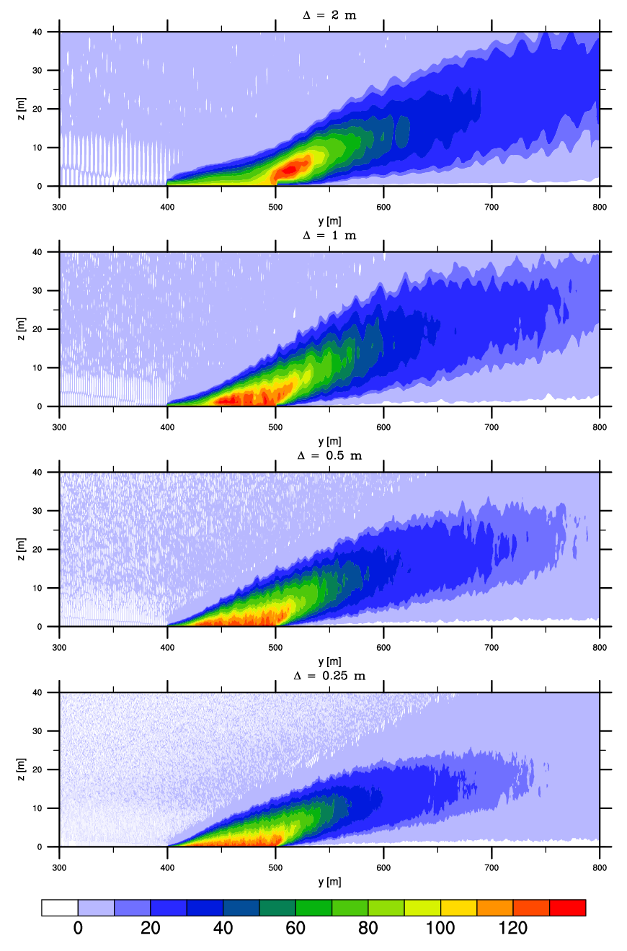
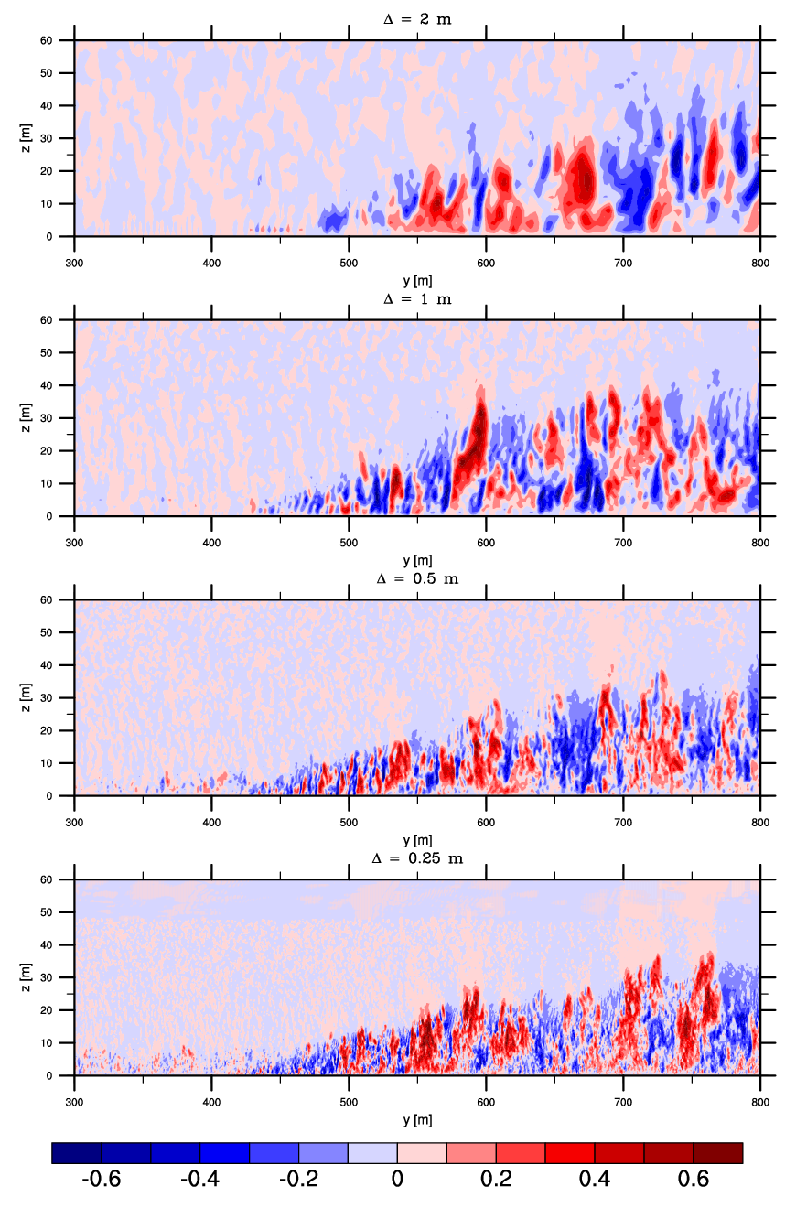
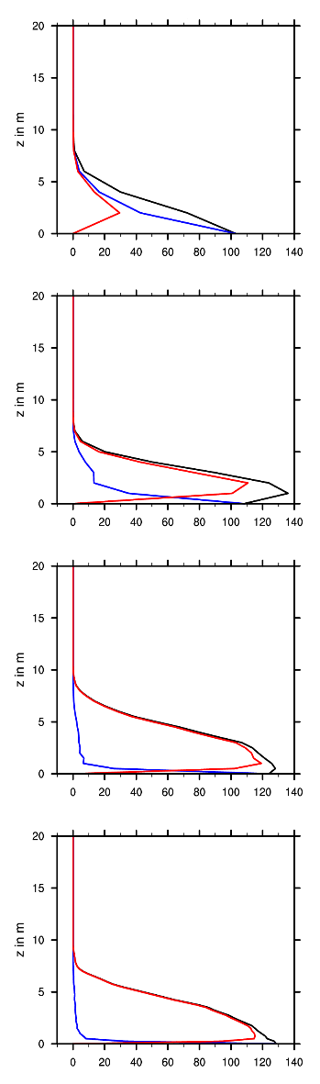
Leads: Effects of Grid Resolution
wind direction
w
ρc_{p}w'θ'
ρc_{p}w'θ'
Δ = 2 m
with increasing resolution onset of convection moves to the upstream edge
pronounced heat flux maximum disappears with higher resolution
contributions of SGS-fluxes become negligible
lead
lead
Δ = 1 m
lead
lead
Δ = 0.5 m
lead
lead
Δ = 0.25 m
lead
lead

Slide 20
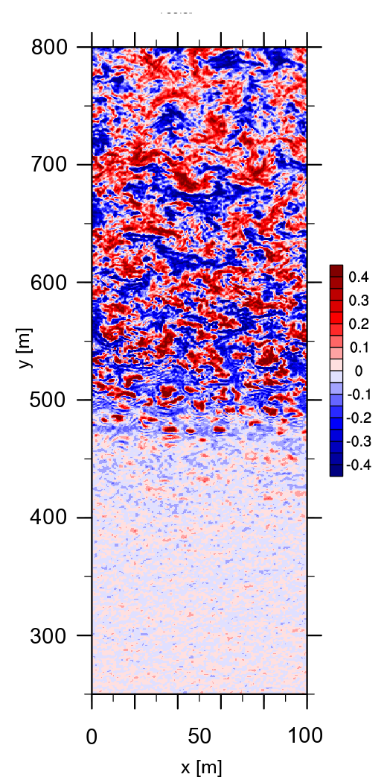
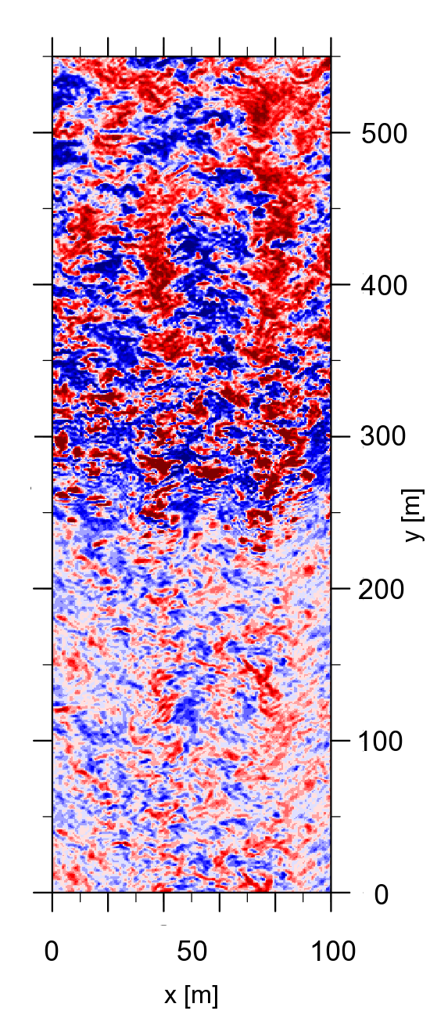
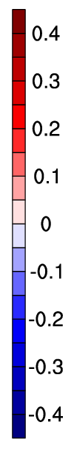
Leads: Effects of Upstream Turbulence
instantaneous vertical velocity in m/s
xy-cross section at z = 10 m
upstream coherent structures trigger the convection pattern above and behind the lead
lead
laminar inflow
turbulent inflow

Slide 21
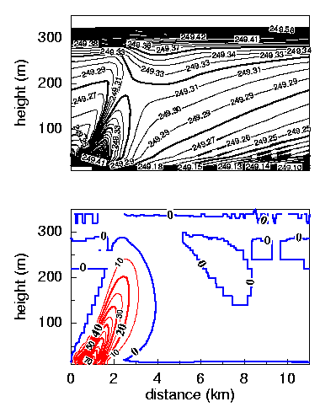
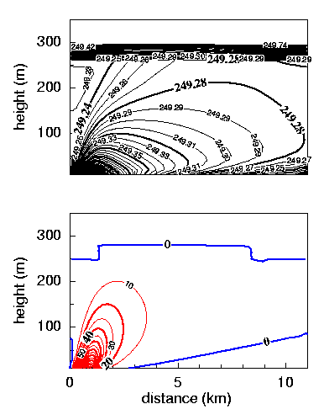
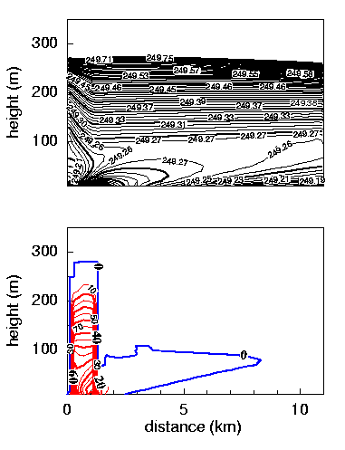
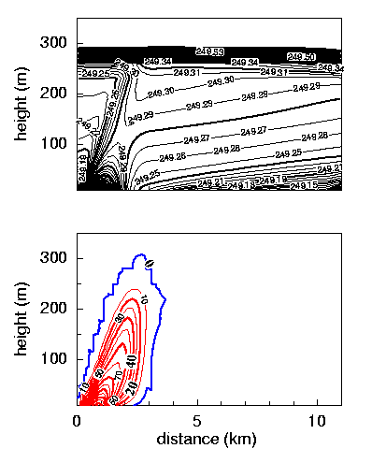
Flow Over Leads: PALM - METRAS Comparison
Using LES data for turbulence parameterizations in larger scale models
PALM
METRAS
local closure
METRAS
non-local closure
METRAS
new improved closure
pot. temperature (K)
pot. temperature (K)
pot. temperature (K)
pot. temperature (K)
strongly
stable
weakly
stable
improved
temperature field
unstable
sensible heatflux (W/m²)
sensible heatflux (W/m²)
sensible heatflux (W/m²)
sensible heatflux (W/m²)
plume is not
tilted
flux
too large
flux too low
Lüpkes et al., 2008: Modelling Convection over Arctic Leads. J. Geophys. Res., 113.

Slide 22
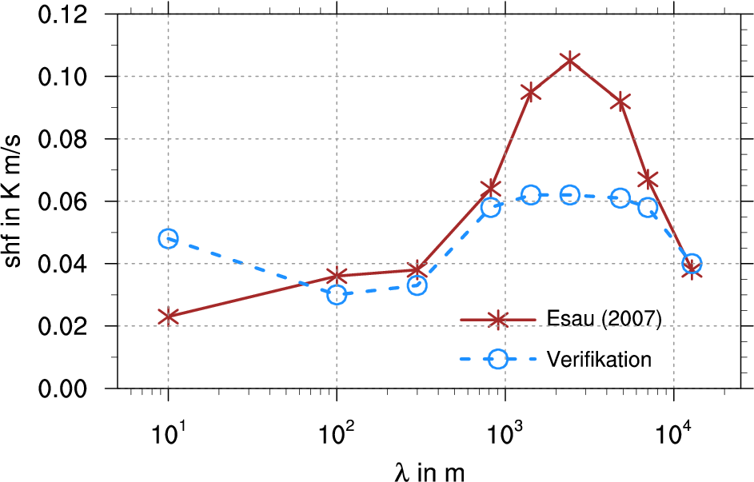
Leads: Relation Between Lead Width λ and Surface Heatflux
z
Esau, 2007: Amplification of turbulent exchange over wide Arctic leads. J. Geophys. Res., 112.
No background wind was used.
mean surface heat flux in K m/s
lead
PALM results
The Esau (2007) study appeared to have several drawbacks.
Most important one: ratio λ / domain width was not held constant!
lead
lead
Notes:
Kommentare:
Gestrichelte Kurve weglassen, verwirrt nur (oder ausführlicher auf Extra-Folie erklären)
Nur auf Nachfrage auf die unterschiedliche Wärmeflussbestimmung eingehen
22

Slide 23
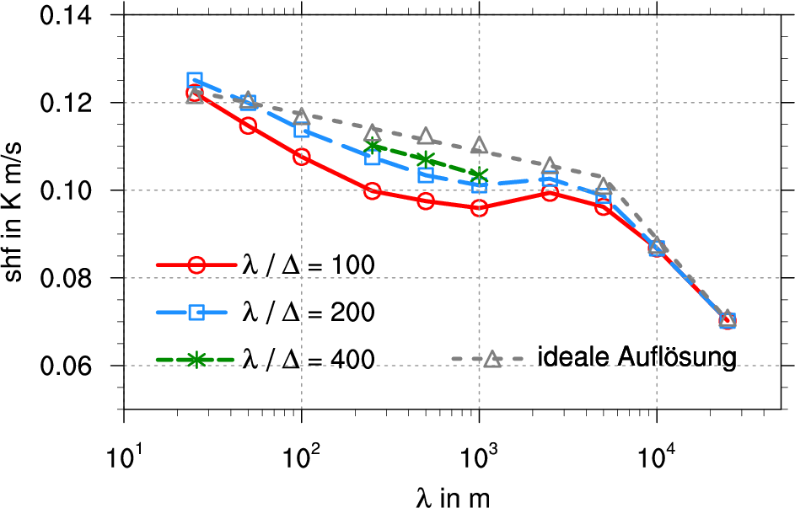
Leads: Relation between Lead Width λ and Surface Heatflux Using λ / domainwidth = const.
mean surface heat flux in K m/s
optimum resolution
New result: linear decrease of surface flux with a scale jump at λ ~ 5000m.
Gryschka et al., 2015: Turbulent exchange above leads studied with high resolution LES. In preparation.

Slide 24
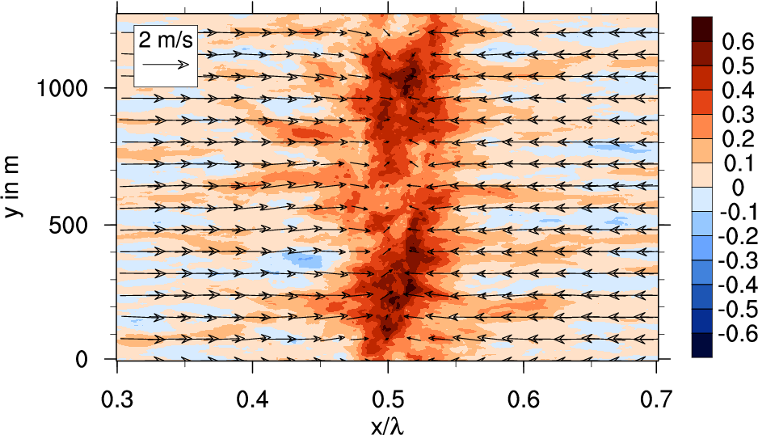
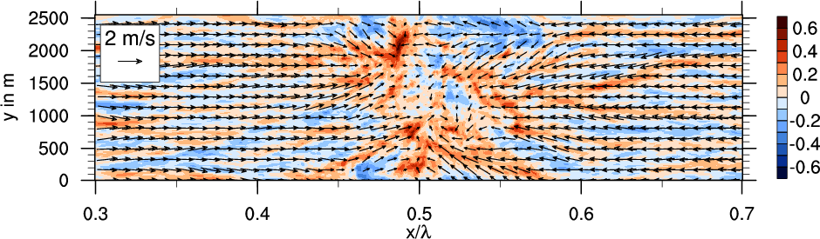
Leads: Dependence of Flow Pattern on λ
λ = 5000 m
For broader leads, flow convergence no more appears at the center of the lead
→overall circulation is weakened, which explains the scale jump
λ = 25000 m
temporally averaged vertical velocity in m/s
Notes:
Vertikalgeschwindigkeit in m/s fehlt!
Hiernach Fazit einbauen!
24

Slide 25
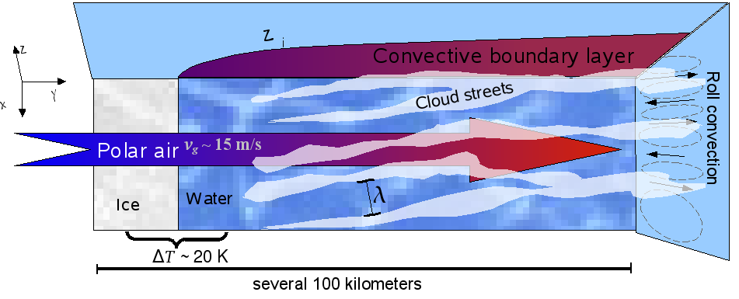
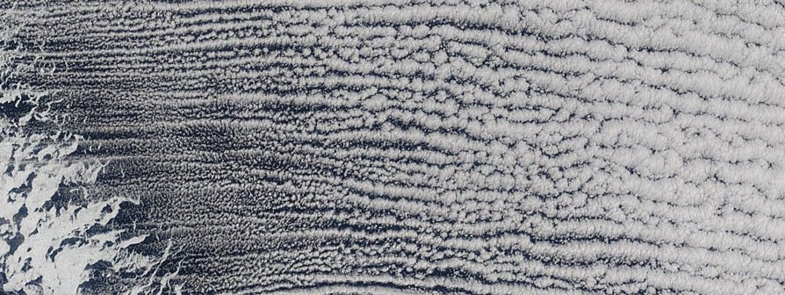
Organized convection during cold air outbreaks
situation requires non-cyclic boundary conditions along x
Satellite image Terra-Modis during a CAO on 23.4.2002 / Davis Strait
400 km

Slide 26

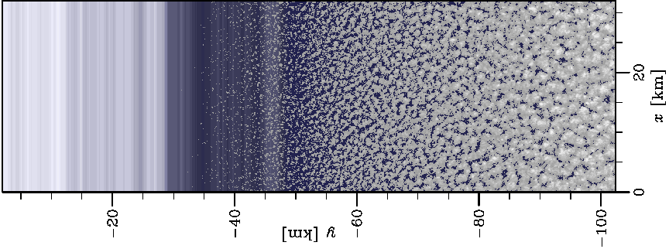
Organized convection during cold air outbreaks
previous LES-results: rolls only if z_{i}/L < 20 (weakly convective, “shear driven”)
rolls in nature are frequently observed with z_{i}/L > 20
geostrophic wind
liquid water path
1d-heterogeneity
(along wind)
PALM simulations
Δ = 50m
8000*1200*200
grid points
y [km]
2d-heterogeneities
Gryschka et al., 2008: Geophys. Res. Lett.

Slide 27
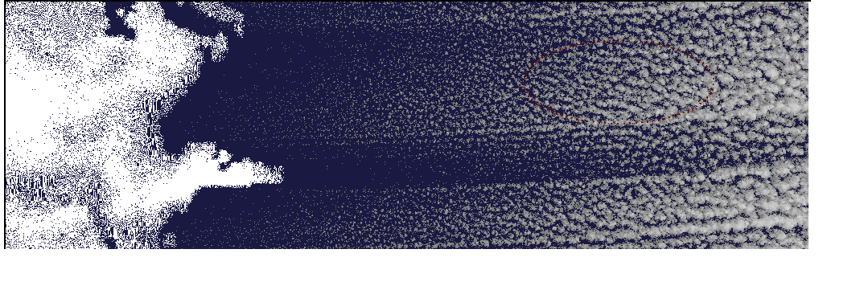
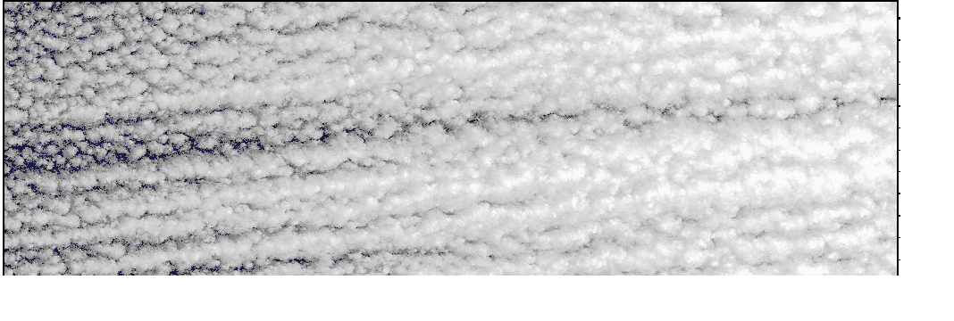
Organized convection during cold air outbreaks
Simulation with observed ice cover (from Terra-Modis satellite)
geostrophic
wind
satellite image Terra-Modis during a CAO on 23.4.2002 / Davis Strait
...
400 km
400 km
Question: Is there any additional heat transport due to the organized convection (rolls)?

Slide 28
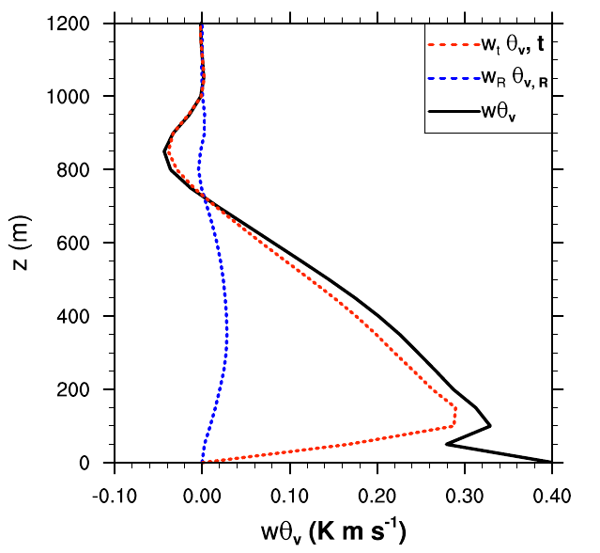
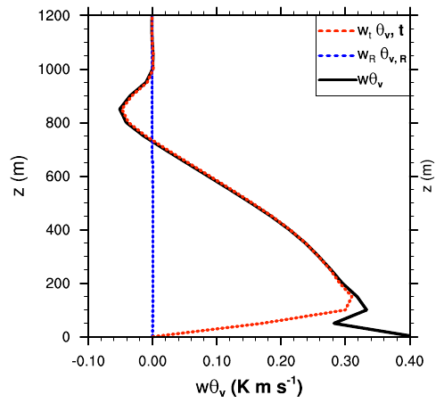
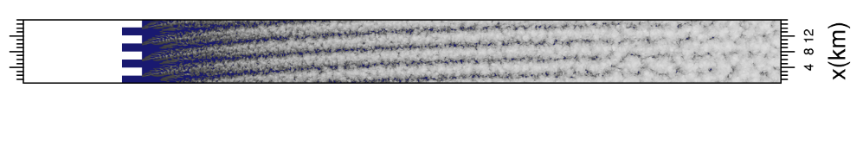
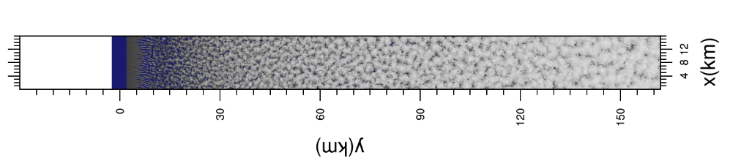
Organized convection during cold air outbreaks
Heat transport by rolls:
total transport
roll transport
y = 80 km
rolls do not change the total transport of heat
Gryschka et al., 2014: J. Geophys. Res, 119.

Slide 29
Motivation for a coupled ocean-atmosphere LES
  Convective structures in ocean and atmosphere might interact and effect the overall heat exchange between the interface.
  However the turbulence is organized on largely different spatial and time scales in each media and influenced by complex physical processes at the interface.
  The technical development was motivated (payed) by Igor Esau (NERSC, Bergen), Yign Noh (Yonsei Univ., Seoul),
  and Jong-Hwan Yoon (RIAM, Kyushu Univ., Fukuoka)

Slide 30
PALM equations (atmosphere)
momentum
liquid water potential temperature
specific humidity

Slide 31
PALM equations (ocean)
momentum
potential temperature
Density ρ = ρ(S,θ,p_{h}) is calculated from the equation of state for seawater using the algorithm from Jackett et al. (2006)
salinity

Slide 32
PALM SGS-Model
SGS-parameterization after Deardorff:
in ocean

Slide 33
Ocean-Atmosphere Coupling in PALM:
General Method
atmosphere to ocean coupling through Prandtl-Monin-Obukhov sublayer
(constant flux layer)
ocean to atmosphere coupling through flux conservation
variables implemented: momentum, heat, humidity/salinity
no precipitation effects
wave effects at the interface are not accounted for
(z₀ ~ u*² is implement)
θ(z_{p}), q(z_{p})
u(z_{p})
Prandtl-layer
θ(z₀), q(z₀)=q_{s}
u(z₀)=0
θ(top)_{ocean}

Slide 34
Ocean-Atmosphere Coupling:
Flux Equations
ocean heat flux depends on atmospheric sensible AND latent heat flux (evaporation)
increase of salinity due to evaporation by salinity flux (after Steinhorn, 1991: JPO)
momentum

Slide 35
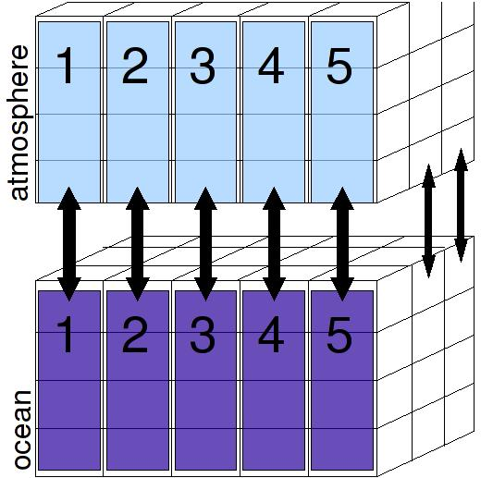
Ocean-Atmosphere Coupling:
Technical Realization (I)
1
2
3
1-1, or n-m coupling can be used
boundary information is exchanged after given time intervals (120 s)
before the coupling, each model can run seperately in order to allow for development of quasi-steady turbulence (different spin-up times in atmosphere and ocean)
pre-run atmosphere
atmosphere
coupled run
ocean
pre-run ocean
0
time

Slide 36
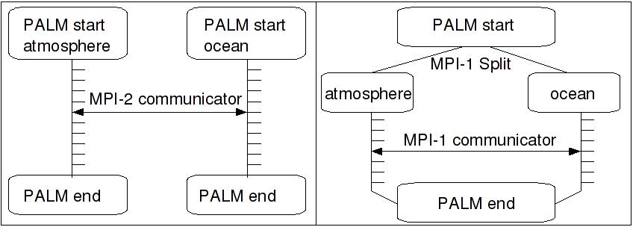
Ocean-Atmosphere Coupling:
Technical Realization (II)
communication between the two models is realized with MPI
MPI-2 intercommunicators allow to couple two different executables,
however the full MPI-2 standard is hardly available
MPI-1 starts only one executable, splits the total number of processors and calls the different models as subroutines
mpiexec -np8 palm &
mpiexec -np8 palm &
mpiexec -np16 palm
8 processors
8 processors

Slide 37
Coupled Simulations: Shear Free Convection (I)
Esau, 2014: Indirect air-sea interactions simulated with a coupled turbulence-resolving model. Ocean Dynamics, 64, 689-705.
first simulations with PALM in coupled mode
potential
temperature
salinity
initial conditions

Slide 38
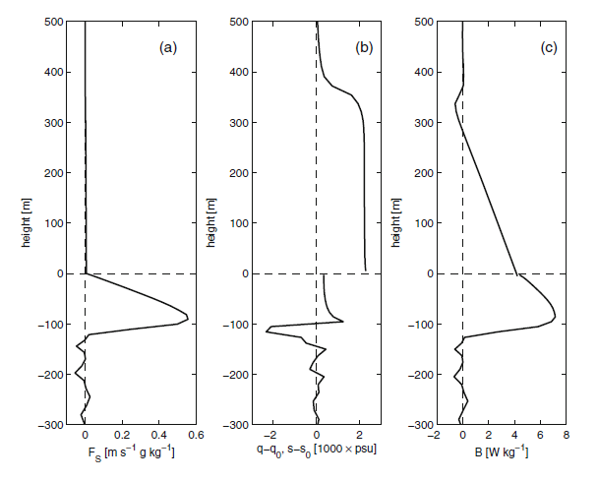
Coupled Simulations: Shear Free Convection (II)
mean profiles in „equilibrium state“
pot. temperature
total heat flux
momentum flux
humidity/salinity flux
humidity/salinity change
buoyancy flux

Slide 39
Coupled Simulations: Shear Free Convection (III)
instantaneous density
fluctuations after 20h
most co-variated patterns (first eigenvector) of the ABL-OML system
questions / problems:
  Why do structures in atmosphere and ocean have the same scale?
  Do the coupled organized structures enhance the energy transport?

Slide 40
Cold Air Outbreaks: Effects on the OML Transport? (I)
Hypothesis:
stationary atmospheric circulations may induce a corresponding circulation in the ocean
domain size is too large for a fully coupled simulation
cyclic ocean domain is driven with atmospheric fluxes averaged along x
y = 25 km
flow convergence and cooling at different positions may be unfavourable to create an ocean circulation
averaged surface fluxes and flow at y = 25 km

Slide 41
Cold Air Outbreaks: Effects on the OML Transport? (II)
initial profiles in ocean:
after 65 h of heterogeneous forcing only very weak circulations are present
surface wind field seems to be the driving force
vertical cross sections after 65 h, averaged along x

Slide 42
Cold Air Outbreaks: Effects on the OML Transport? (III)
What happens in case of Stokes drift?
→ onset of a strong Langmuir circulation
vertical cross sections
without Langmuir circulation
vertical cross sections
with Langmuir circulation
So far, no direct signs for coupled atmosphere ocean circulations / interactions under convective conditions

Slide 43
Summary / Comments
LES is a valuable tool for studying turbulent boundary layer processes
Compared to the atmospheric boundary layer, there are still only few LES applications for the OML so far
Coupled ocean-atmosphere LES are still at the very beginning, and it is unclear, under which conditions a coupling really makes sense
(PALM would be a suitable tool for such studies, so if you have any idea …)

Slide 44
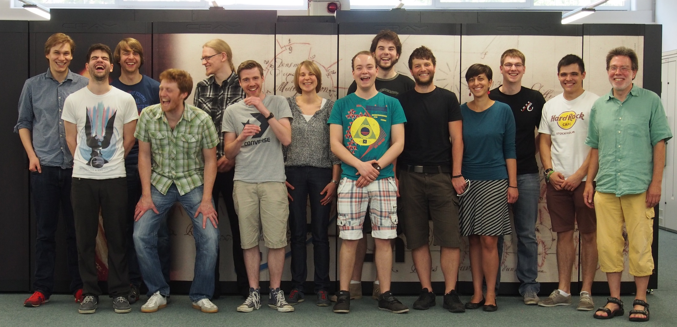
Fabian Hoffmann
Dr. Christoph Knigge
Dr. Björn Maronga
Dr. Rieke Heinze
Simon Ward
Jens Fricke
Sebastian Giersch
Lennart Böske
Helge Knoop
Marius Keck
Manuel Dröse
Dr. Matthias Sühring
Farah Kanani
Prof. Siegfried Raasch
PALM group at IMUK in front of the Cray XC-40 at HLRN (May 2014)
45000 cores 1.4 PFlop/s

Slide 45
Thank You!

